Slide 1
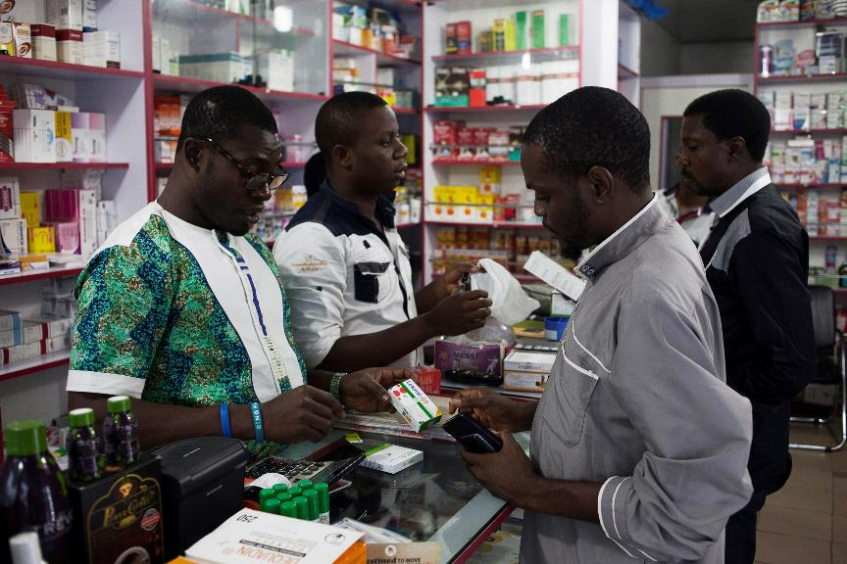

[COUNTRY, YEAR]
Module 2: Antimalarial
product audits

Slide 2
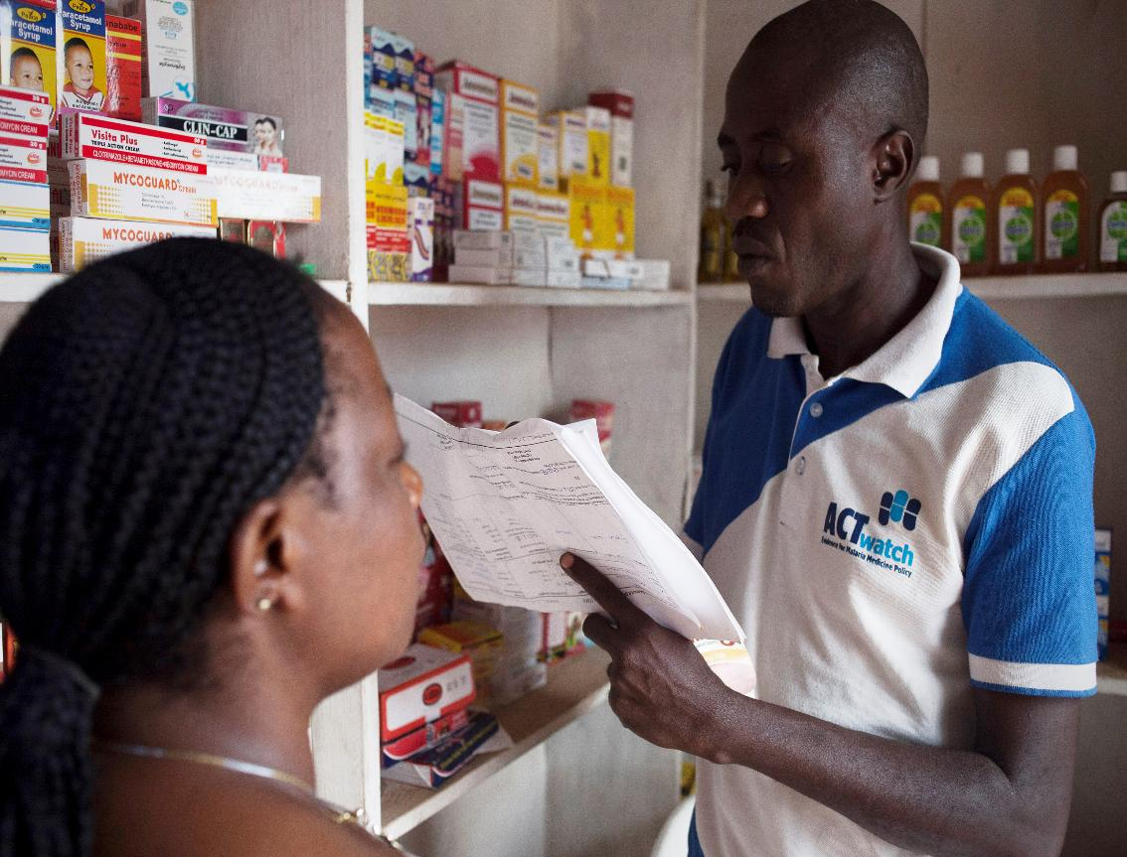
Agenda
2.1 Generic and brand names
2.2 Dosage form, strengths, and salts
2.3 Pack type and size
2.4 Quantity sold and stock outs
2.5 Retail and wholesale prices
Notes:
1.8. Generic and brand names and main classes of antimalarial drugs
1.9. Form and dosage
2.2. Pack size
2.3 Quantity sold and stock outs
2.4. Retail and wholesale prices

Slide 3
In this module, you will learn everything you need to know to complete aN AUDIt of Antimalarial drugs
What is an audit?
For this study, we will define it as: A systematic collection of all relevant data about a product.
At each outlet visited for the study, you will conduct an interview with the provider AND an audit of ALL of their antimalarial drugs and RDTs.

Slide 4
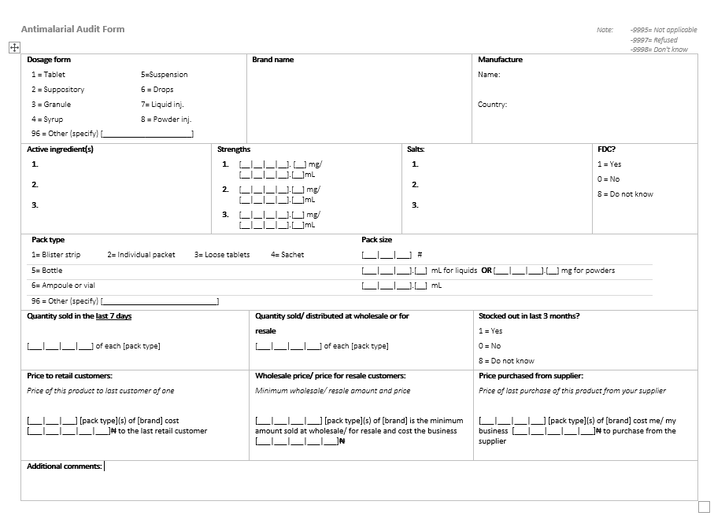
For the training we will use a paper audit form for practice
During the study we will use a digital version on tablets

Slide 5
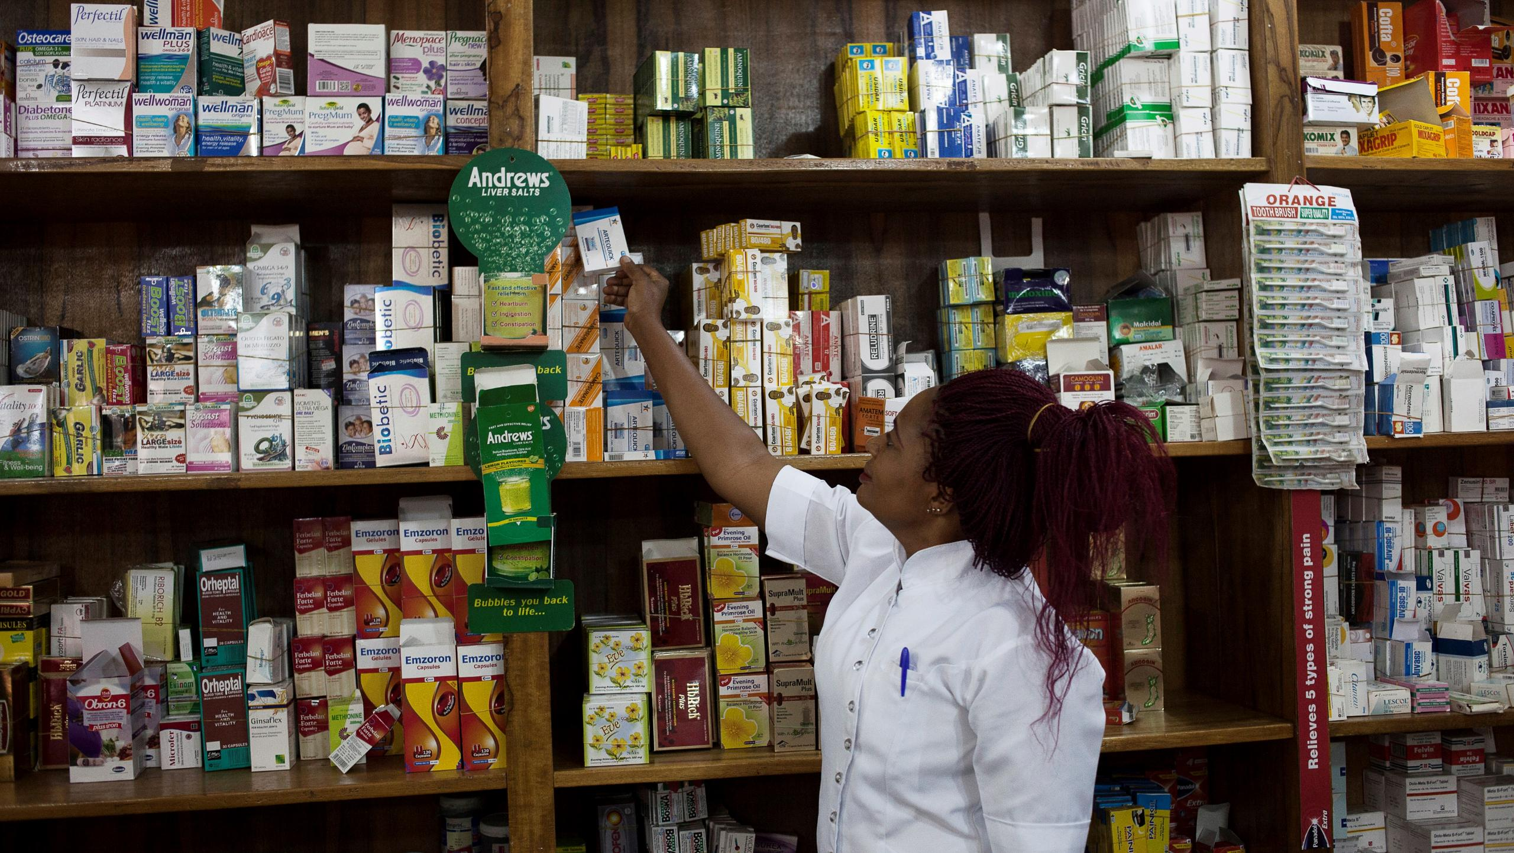
2.1 Generic and brand names

Slide 6
TRAINER NOTES
Objective:
Help data collectors identify and accurately record the brand name of antimalarial products from the packaging.
Prompts & Answers:
What is a brand name? ➔ The marketing name given by the manufacturer (e.g., Coartem®, P-ALAXIN)
Where is it usually found? ➔ On the front of the box, written in large/bold font, sometimes with ™ or ®
What extra info is part of the brand name? ➔ Include age/weight, formulation (e.g., Camosunate Junior, Artesiane 80)

Slide 7
PROGRESS THROUGH THE AUDIT FORM SECTIONS
Brand name
Generic name/ active ingredients
Manufacturer
Country of manufacture
Dosage form
Strengths and excipients
Packaging type
Pack size
Quantity sold
Stock outs
Prices
Topic covered in this section

Slide 8
Main objective: To be able to fill in antimalarial drug audit forms accurately and correctly
At the end of this presentation, you should be able to:
Recognize generic and brand names on drug packaging and distinguish between the two categories of names;
Determine the number and types of active ingredient(s) a drug
Remember the generic names of the most common antimalarial drugs.
Identify the manufacturer and country of manufacture on the drug packaging;

Slide 9
Who among you has ever had malaria?
What MEDICATION did you receive?

Slide 10
In general, a drug is referred to by two names
Generic name
Indicates which chemical component the medicine is made up of, called active ingredient(s)
This is the official, standardized name given to a pharmaceutical substance by the WHO.
Has a chemical sound
Brand name
This is the name that the manufacturer gives to its product and under which it is sold.
Often followed by the ® or ™ symbol.
Often written boldly and prominently on the packaging
May be followed by "Adult", "Child", "Baby", "Pediatric", "Junior", etc.
Some medicines have no brand name: they are called "generics".

Slide 11
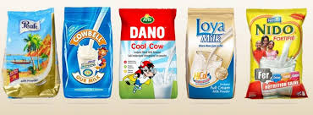
Example: Generic and brand names for non-medicine product
Let’s think about powdered milk (maybe you use it in your tea or coffee?) - You can find different brand names for powdered milk:
However, the contents of the box and therefore the generic name of all these brands are the same:
Powdered milk

Slide 12
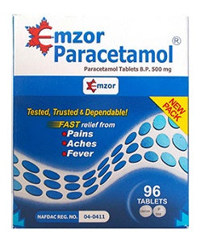
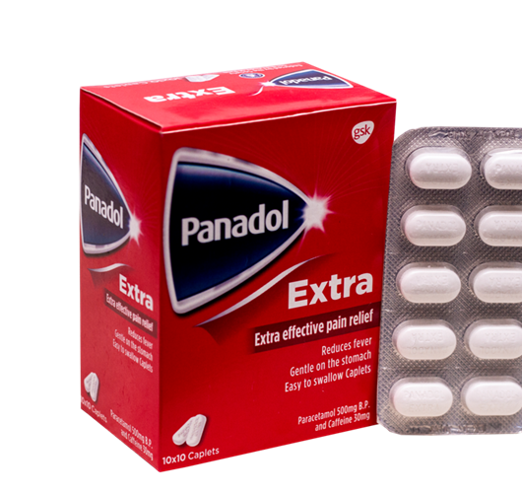
EXAMPLE: Medicine
Generic name:
Paracetamol
Brand names:
Mzor
Panadol
... and others?

Slide 13
Can you think of any other examples of Generic Names and Brand Names for drugs?

Slide 14
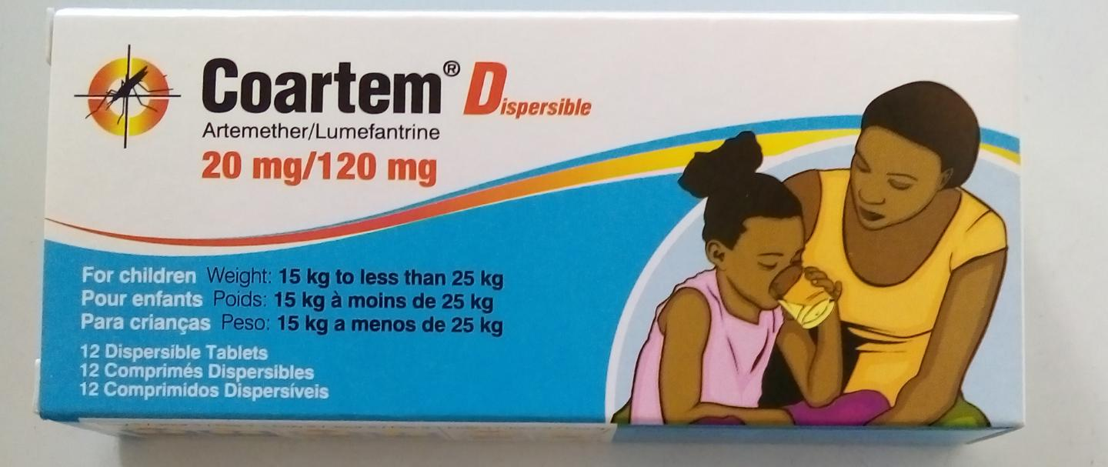
Important note about Brand Names FOR THIS STUDY
When recording information manually* about an antimalarial, include any words or numbers that follow the brand names such as :
"Pediatric, Adult, Child
"Dispersible
"20/120"
Ages, "1-5 years »
Weights, "15-25 kg »
*NOTE! Many products included in a database of known products will not have trademarks, strengths, or information on ages, weights, etc. but sufficient information to match your product to the list
Regardless, for MANUAL entry, we want to collect as much information as possible!
e.g. Coartem Dispersible 20mg/120mg For Children would be ideal input for brand name

Slide 15
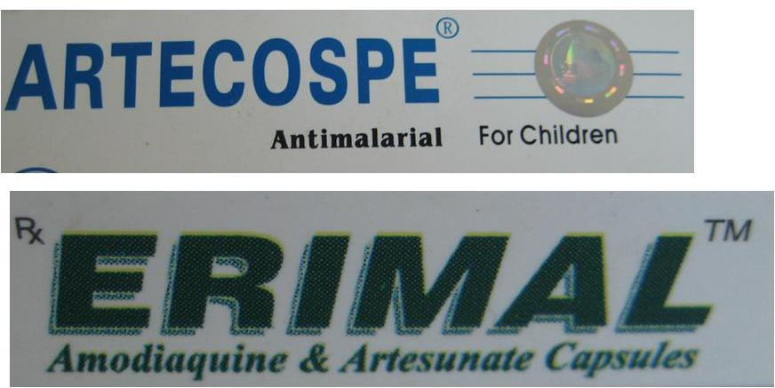
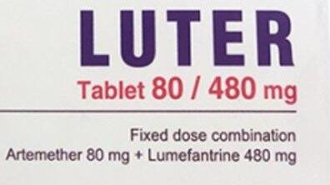
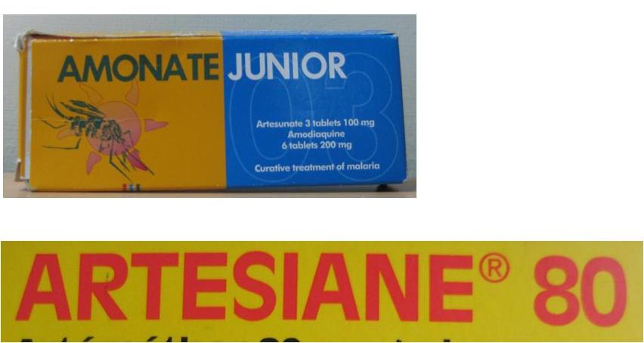
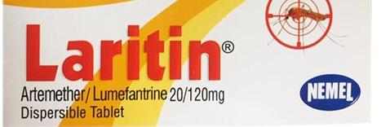
Examples of brand names
Artecospe
Luter Tablet 80/480 mg
Amonate Junior
Erimal
Artesiane 80
Laritin Dispersible 20/120

Slide 16
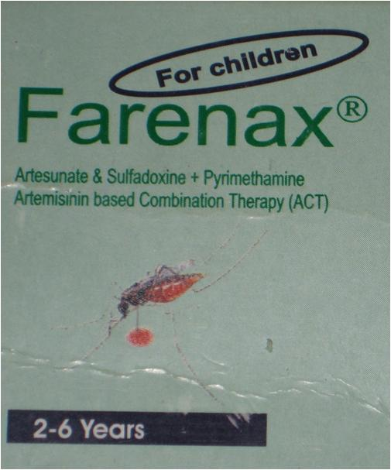
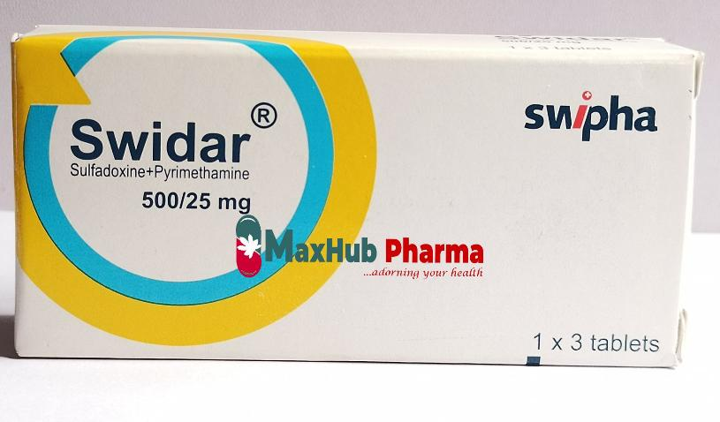
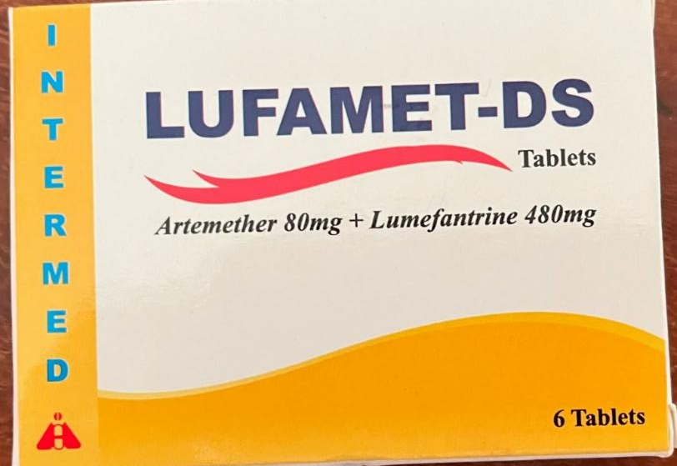
Examples of brand names
Swidar 500/25 mg
Farenax For Children
Lufamet-DS

Slide 17
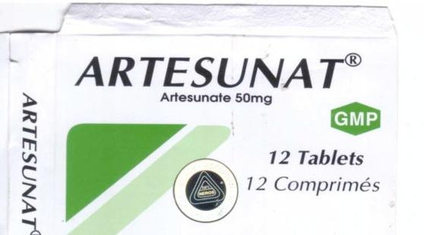
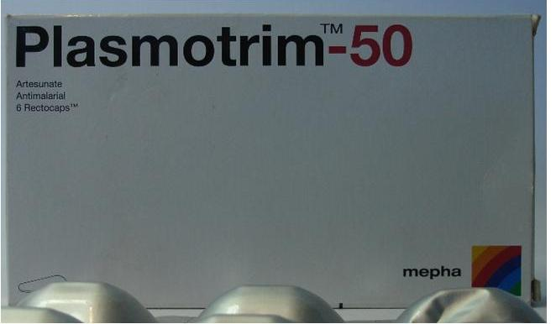
Examples of brand names
Artesunat
Plasmotrium-50

Slide 18
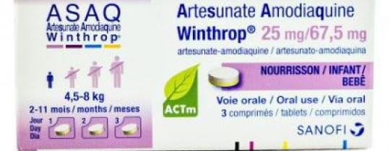
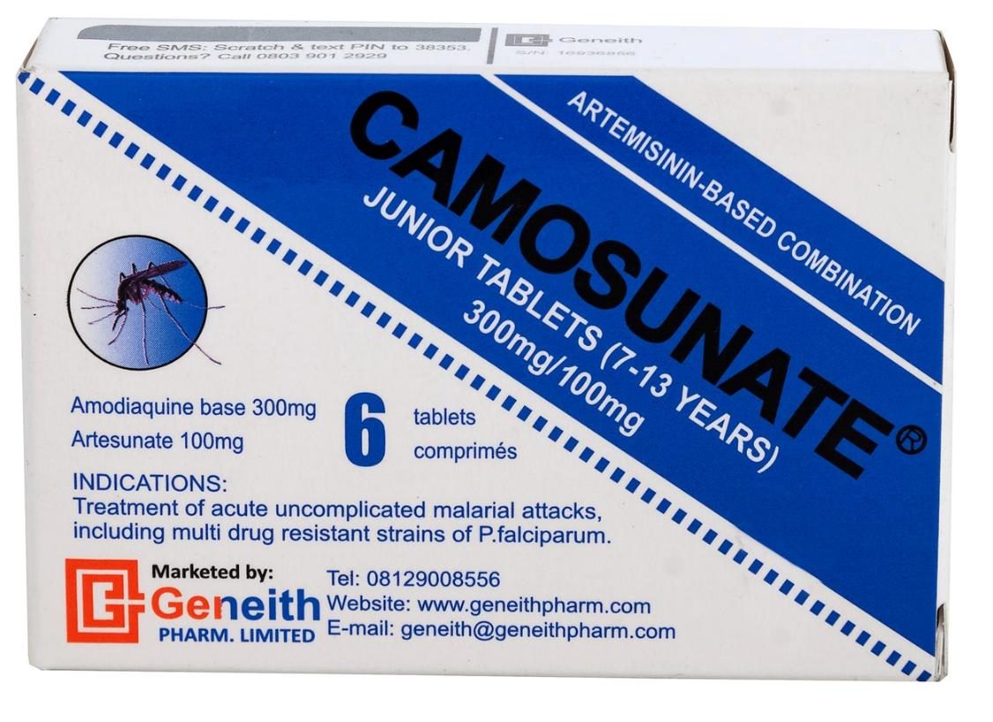
Examples of brand names
Winthrop 25mg/67,5 mg
Camosunate Junior Tablets (7-13 years)

Slide 19
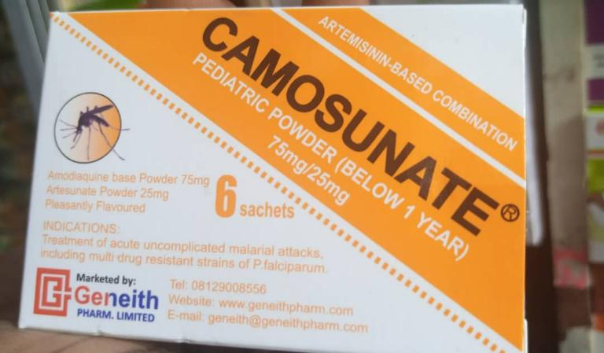
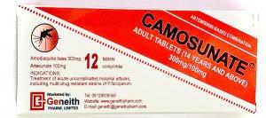
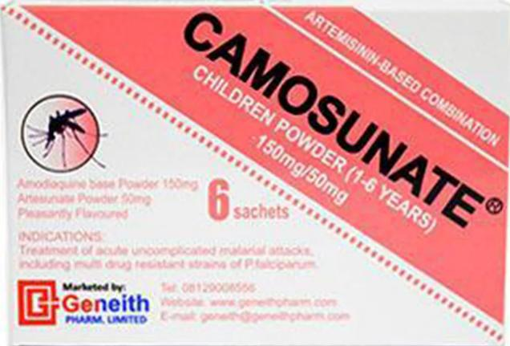
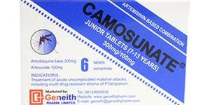
Examples of brand names
CAMOSUNATE ADULT TABLETS (14 YEARS AND ABOVE)
CAMOSUNATE PEDIATRIC POWDER (BELOW 1 YEAR)

Slide 20
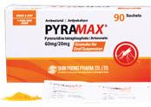
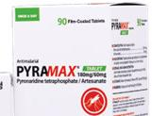
Examples of brand names
PYRAMAX
GRANULES FOR ORAL SUSPENSION 60/20
PYRAMAX
TABLET 180/60

Slide 21
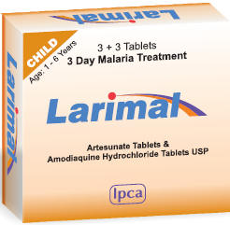
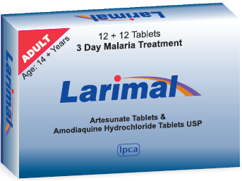
Examples of brand names
LARIMAL
CHILD
LARIMAL
ADULT

Slide 22
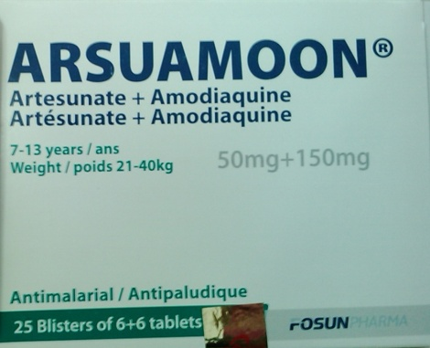
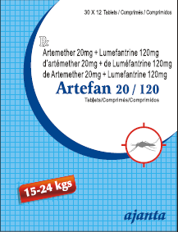
Examples of brand names
ARSUAMOON 50 MG+150MG 7-13 YEARS
WEIGHT 21-40KG
ARTEFAN
20/120

Slide 23
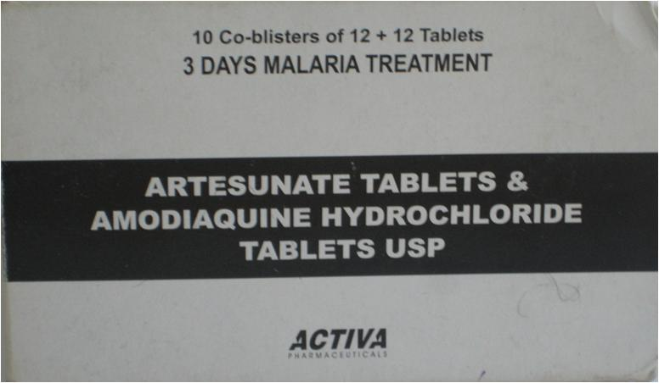
What about products with no brand name?
Some antimalarials are unbranded, or have no brand name visible. In these cases, you will record only its generic name.
ARTESUNATE TABLETS & AMODIAQUINE HYDROCHLORIDE TABLETS USP
Notes:
USP = United States Pharmacoepia – standardized drug classification system\

Slide 24
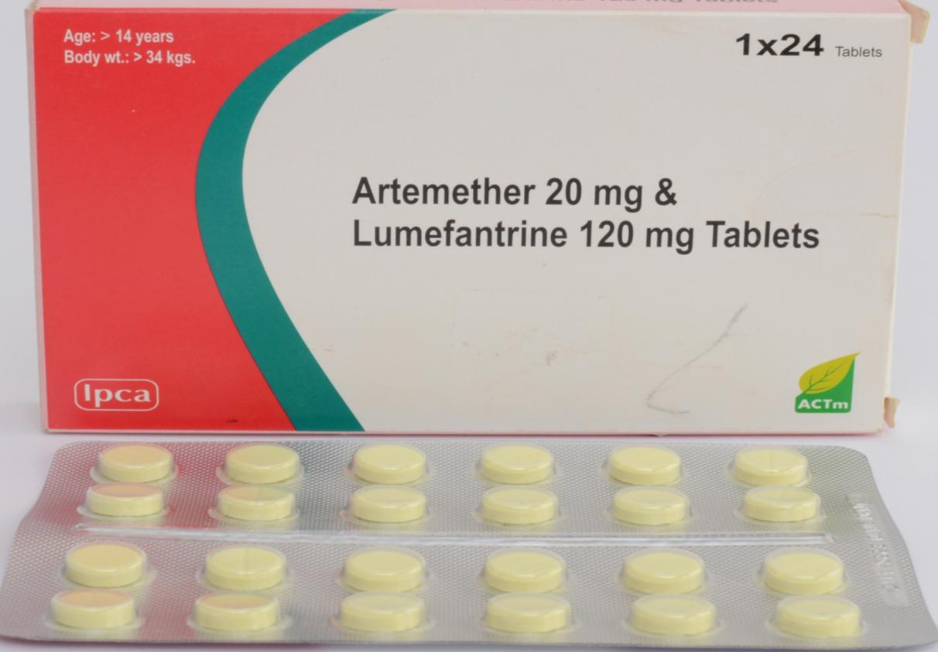
Examples of Unbranded PRODUCTS
Artemether 20 mg & Lumefantrine 120 mg Tablets
AGE >14 YEARS WEIGHT >34KGS

Slide 25
Active ingredients and Generic names

Slide 26
Reminder: What is the Generic Name of a drug?
The generic name:
Indicates which chemical component(s) the medicine is made up of, called active ingredient(s).
This is the official, standardized name given to a pharmaceutical substance by the WHO.

Slide 27
Medicines can have one or more active ingreDients → The generic name refers to all active ingreDients
An antimalarial drug can have 1 active ingredient
Example: Mefloquine (generic name: Mefloquine)
An antimalarial drug may have 2 or more active ingredients
Example: Artesunate+ Mefloquine (Generic name: Artesunate Mefloquine)
The two active ingredients are indicated as the Generic Name

Slide 28
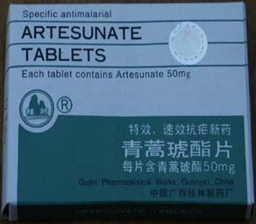
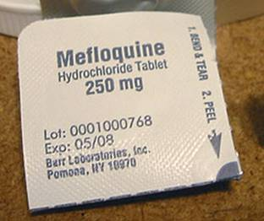
Examples: 1 active ingredient

Slide 29
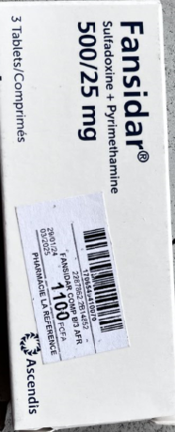
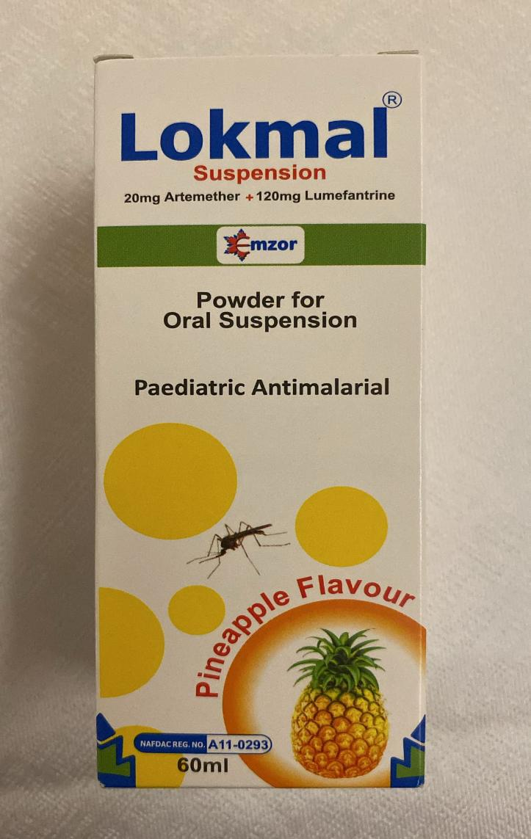
Examples: 2+ active ingredientS

Slide 30
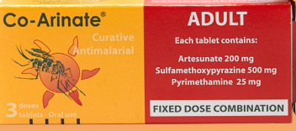
Examples: 3 ACTIVE INGREDIENTS

Slide 31
What are the most common ACTIVE INGREDIENTS IN antimalarials?
Non-artemisinin
Artemisinin
Quinine
Amodiaquine
Sulfadoxine
Sulfamethoxypyrazine
Pyrimethamine
Chloroquine
Mefloquine
Halofantrine
Lumefantrine
Pyrimethamine
Piperaquine
Artesunate
Artemether
Dihydroartemisinin
Artemisinin
Artéether (also known as Artémotil)
And combinations

Slide 32
ARTEMISININ- BASED COMBINATION THERAPY (ACT)
Common generic names:
An ACT is 1 drug with 2 active ingredients. The structure is generally:
Artesunate
Artemisinin
Artemether
Dihydroartemisinin
Artéether (also known as Artémotil)
Other active ingredient

Slide 33
ARTEMISININ- BASED COMBINATION THERAPY (ACT)
Common generic names:
Artemether + Lumefantrine
Artesunate + Amodiaquine
Artesunate + Sulfadoxine-Pyrimethamine (SP)
Dihydroartemisinin + SP
Dihydroartemisinin + Piperaquine phosphate
Artesunate + Mefloquine
Artemisinin + Naphthoquine
Artesunate + Pyronaridine

Slide 34

Important
If you know the generic names mentioned in the previous slides, you'll be able to identify an antimalarial drug and distinguish it from other medicines!

Slide 35
we are only interested In TRUE antimalarial drugs!
There are other classes of drugs that are not antimalarials but are sometimes prescribed to someone with malaria...
Some of the other drug classes are:
Antibiotics (eliminate bacteria)
Antipyretics (to relieve fever)
Antiemetics (prevent nausea)
Other commonly prescribed drugs...
Antibiotics
Metronidazole
Amoxicillin
Cotrimoxazole
Gentamicin
and others?
Antipyretics
Paracetamol
Aspirin
Ibuprofen
Metamizole
and others?
Antiemetics
Domperidone
Dramamine
Metoclopramide
and others?
Other commonly prescribed drugs
Multivitamins; folic acid
Other antiinfectious drugs (eg. Mebednazole, Nystatin, etc)
Dexamethsone, etc.
https://malariajournal.biomedcentral.com/articles/10.1186/s12936-018-2332-3/tables/5

Slide 36
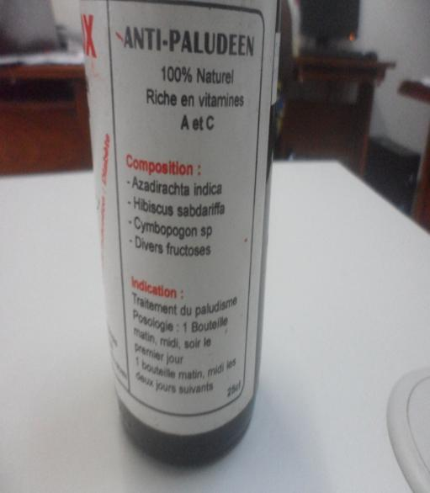
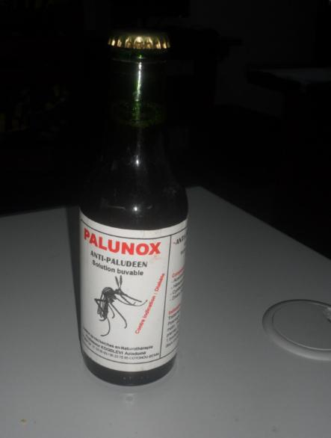
Other drugs used to treat malaria
What's more, we're only interested in those antimalarial drugs with at least one active ingredient that we've discussed today.
We do not audit extracts from plants, such as:
Api-palu
Palunox
Fabrics
We are only interested anti-malarial pharmaceuticals

Slide 37
Manufacturer & Country of manufacture

Slide 38
Manufacturer
This refers to the parent company that manufactures the drug or holds the production licences
Country of manufacture
This is the country where the drug was physically prepared or produced.
These definitions are important because packages often have multiple companies and countries listed on them!

Slide 39
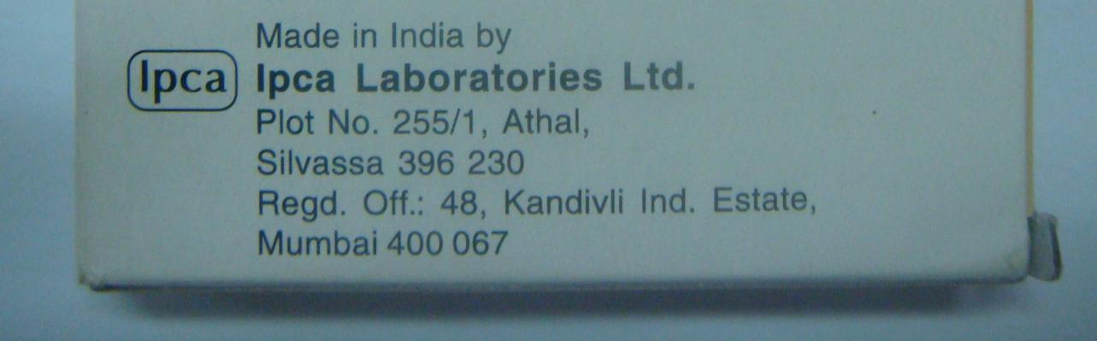
Manufacturer
If only one company name is written on the packaging, note this name on the audit form as "Manufacturer".

Slide 40
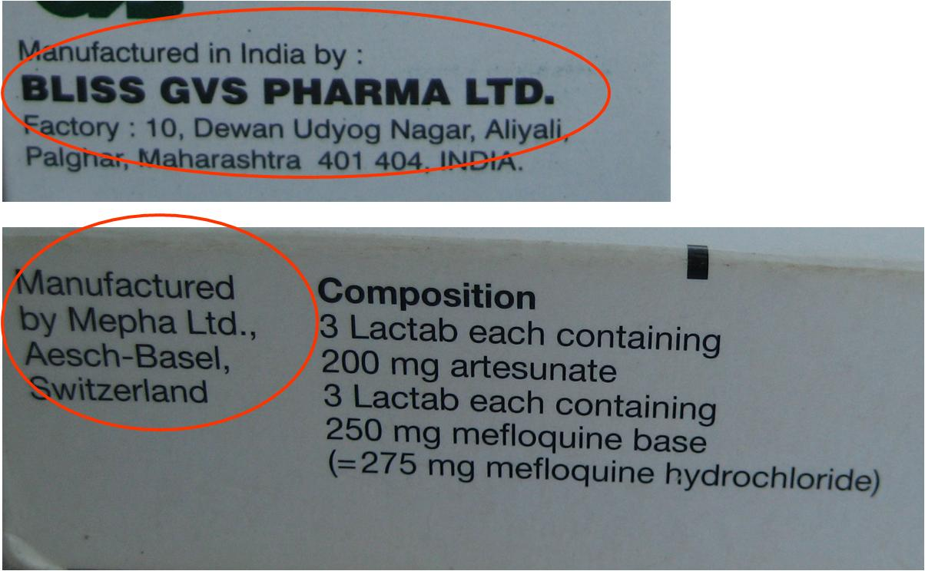
MANUFACTURER EXAMPLES - 1 NAME

Slide 41
In all cases below, Y is the manufacturer in all cases. Not X!
Manufactured by X on behalf of Y
Manufactured by X for Y
License owned by Y
Manufactured by X for Y
Made by X under license of Y
Made by X on behalf of Y
Made by X for Y
If there are several company names on the box, there are key terms on the packaging that help identify which company is the manufacturer.

Slide 42
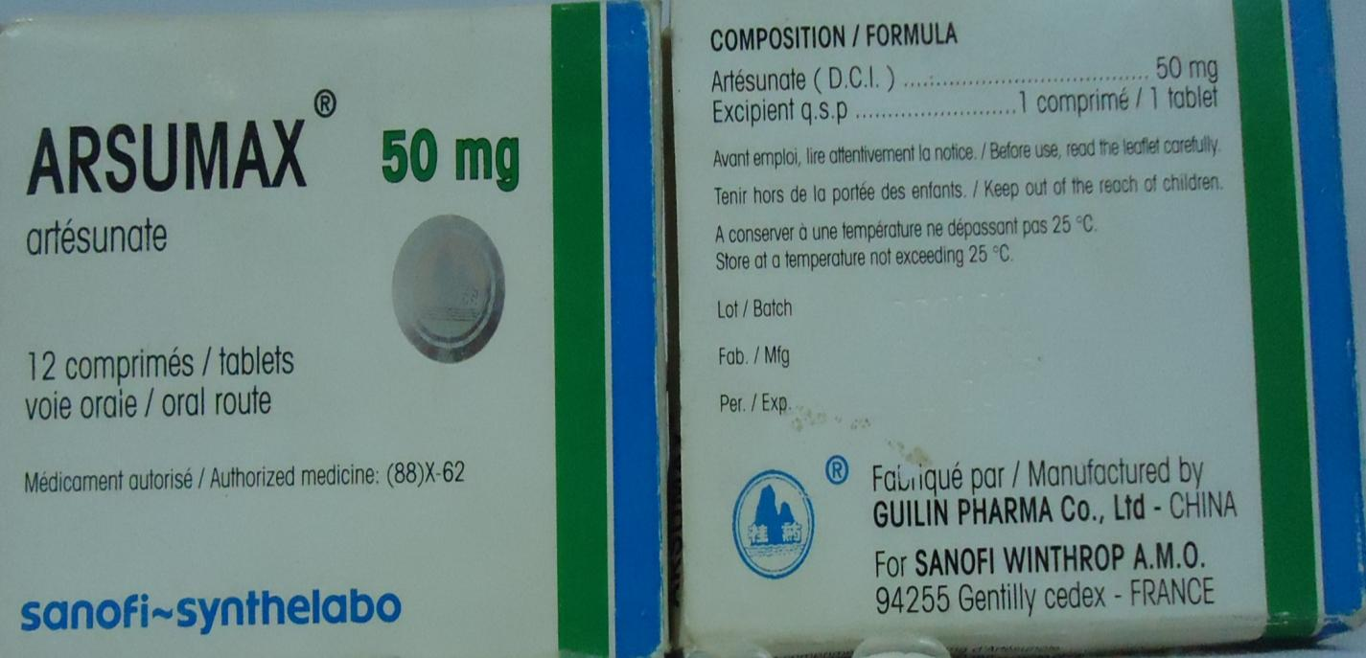
MANUFACTURER EXAMPLES - 2 NAMES
MANUFACTURER: SANOFI WINTHROP A.M.O, not GUILIN PHARMA CO. LTD
COUNTRY: CHINA

Slide 43
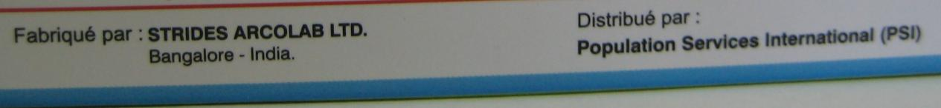
If there are several company names on the box, there are key terms on the packaging that help identify which company is the manufacturer.
Other company types may be written on the packaging:
For example, when it says:
"Distributed by Z
"Sold by Z"
"Packed by Z«
Company Z is not the Manufacturer.
Here, the manufacturer is Strides Arcolab Ltd.

Slide 44
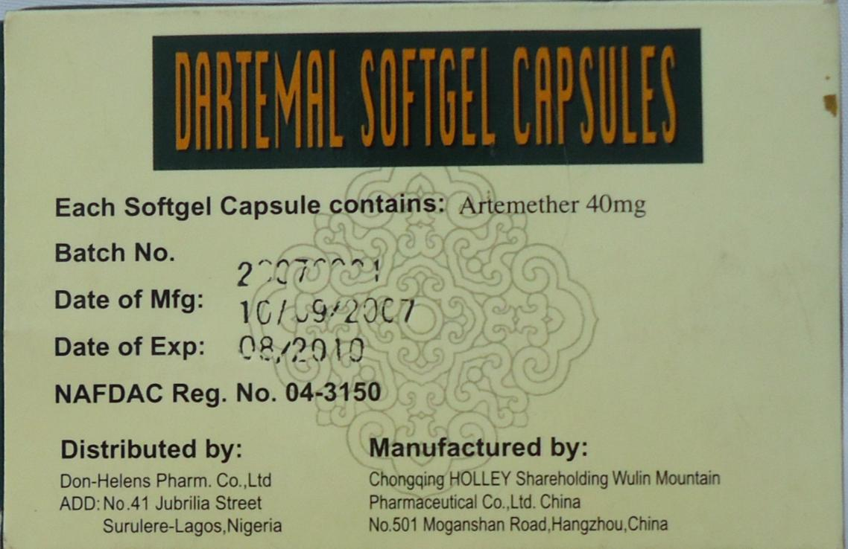
Other company types may be written on the packaging
Here, the manufacturer is Chongqing Holley Shareholding Wulin Mountain Pharmaceutical Co. LTD

Slide 45
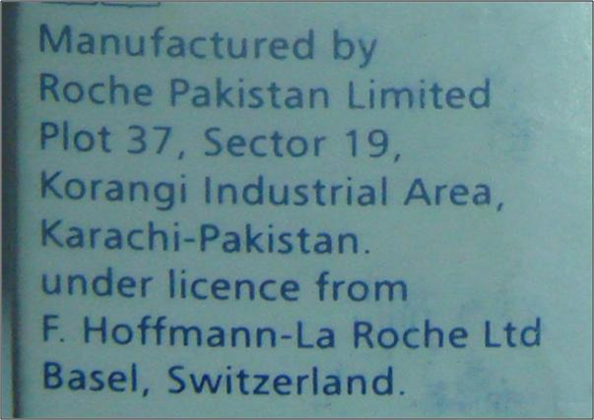
EXAMPLE
In this example:
Who is the manufacturer?
F Hoffman – La Roche
What is the country of manufacture?
Pakistan

Slide 46
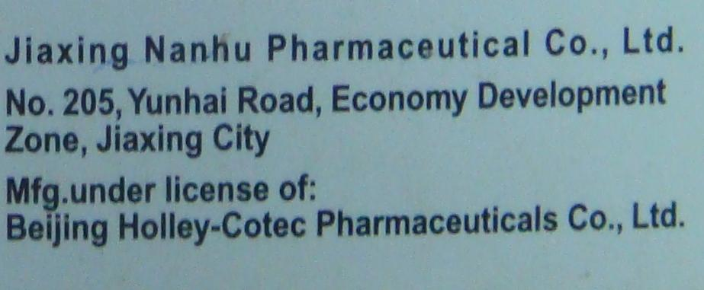
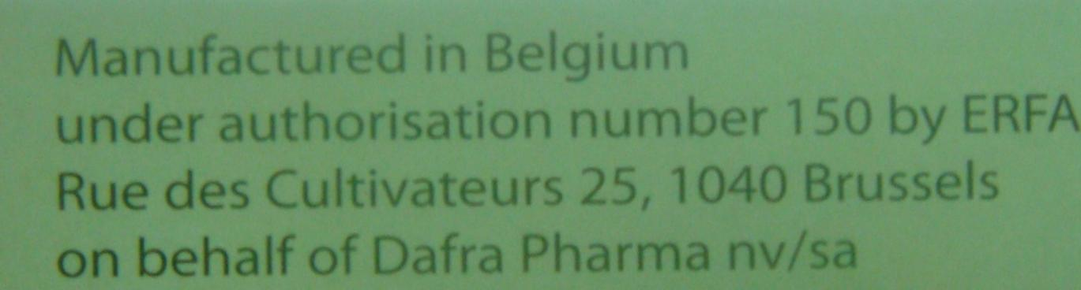
EXAMPLE
Who is the manufacturer?
Beijing Holley-Cotec Pharmaceuticals Co.
What is the country of manufacture?
China or 9998
Who is the manufacturer?
Dafra Pharma
What is the country of manufacture?
Belgium

Slide 47
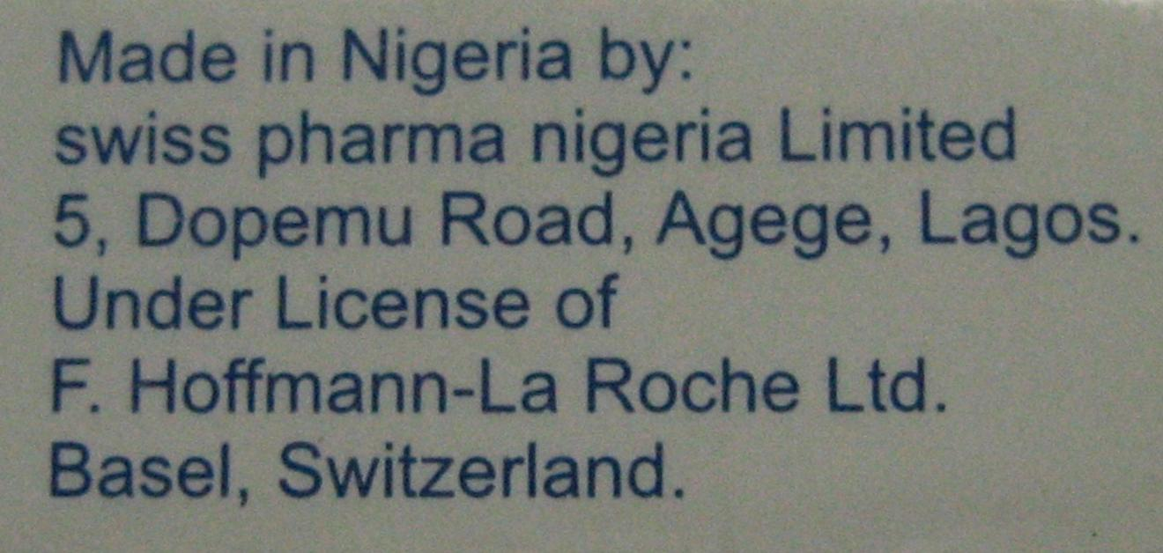
Example
Who is the manufacturer?
F Hoffman La Roche Ltd.
What is the country of manufacture?
Nigeria

Slide 48
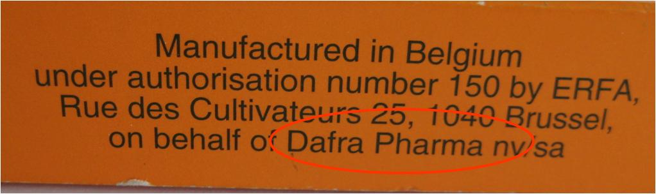
Example
Who is the manufacturer?
Dafra Pharma
What is the country of manufacture?
Belgium (Belgium)

Slide 49
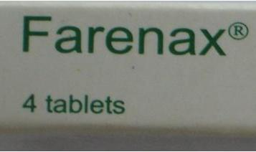
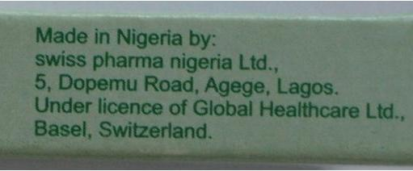
Example
Who is the manufacturer?
Global Healthcare Ltd
What is the country of manufacture?
Nigeria

Slide 50

Example
Who is the manufacturer?
Denk Pharma Gmbh & Co KG
What is the country of manufacture?
Germany

Slide 51

Example
Who is the manufacturer?
CIPLA LTD
What is the country of manufacture?
India

Slide 52

Example

Slide 53
Summary
What are the 4 main concepts we’ve discussed that can be found on drug packaging?
Generic Name
Brand name
Manufacturer
Country of manufacture
Brand names may not exist for certain drugs
Antimalarials may have 1, 2, or 3 active ingredients that make up the generic name
Packaging may list multiple companies and countries. There are clues to identify the correct manufacturer and country of manufacture

Slide 54
Summary: MANUFACTURER AND COUNTRY OF MANUFACTURE
Manufacturer = parent company that produced the drug/owns the license
If there is more than one company listed, it is "Y" in:
"License belonging to Y
"Manufactured by X for Y".
"Made for Y"
Country of Manufacture = country where the company that actually produced the drug is located

Slide 55

Review:
Who from the group can tell us…?
What is a generic name?
The generic name designates the active ingredient(s).
Is there a difference between a drug's generic name and its active ingredient?
No
How many active ingredients can an antimalarial drug contain?
Antimalarials have 1 to 3 active ingredients
How do you distinguish between generic and brand names?
The brand name can be written with ® or ™ and does not (usually) contain active ingredients
Generic name looks like chemical name

Slide 56

Activity 1
We are going to show you 5 antimalarial drugs.
Note the following on Activity Sheet 1:
Generic name
Brand name
Manufacturer
Country of manufacture
For facilitators:
Use the 5 product images that follow the instructions on the next slide.
Allow approx. 5 minutes per product
The correct information is shown after the images.
Ask data collectors to complete “Worksheet 1”

Slide 57




Slide 58




Slide 59




Slide 60




Slide 61



Slide 62





Slide 63






ANSWERS:
Brand: Coartem 80/480, 35kg and above
Generic name: Artemether Lumifantrine
Manufacturer: Not shown
Country of manufacture: Not shown
Brand: P-alaxin 80/640
Generic name: Dihydroartemisinin Piperaquine
Manufacturer: Bliss GVS Pharma LTD
Country of manufacture: India
Brand: Camosunate 300/100, 14 years and above
Manufacturer: Front Pharmaceutical, PLC
Country of manufacture: China
Brand: Chloroquine syrup
Manufacturer: Mzor Pharmaceutical Industries Ltd.
Country of manufacture: Nigeria
Brand: ArenaxPlus Forte 80/480, 35kg and above
Manufacturer: Swiss Pharma Nigeria LTD
Country of manufacture: India
Active ingredient 1: Artemether Lumefantrine
Brand: Rekmal 120
Generic name: Artesunate
Manufacturer: Lincoln Pharmaceuticals LTD
Country of manufacture: India

Slide 64
YOU SHOULD NOW BE ABLE TO:
Identify the Generic Name on a drug pack.
Identify the brand name on drug packaging.
Remember the generic names of the most common antimalarial drugs.
Determine how many active ingredients a drug contains.
Identify the manufacturer and country of manufacture on the drug packaging.

Slide 65
2.2 Dosage form and strength

Slide 66
TRAINER NOTES
Objective:
Help data collectors correctly identify and record the dosage form, strength(s), and salts from antimalarial product packaging.
Prompts & Answers:
What is a dosage form? ➔ The physical form of the drug (e.g., tablet, syrup, suspension, injection, suppository)
How to know the strength? ➔ It's the amount of active ingredient per unit, written as mg or mg/mL ➔ Solid forms (e.g., tablets): mg ➔ Liquids (e.g., syrups/injections): mg/mL
What is a salt, and where to find it? ➔ It’s a chemical form of the drug (e.g., phosphate, hydrochloride) ➔ Often written after the generic name (e.g., Chloroquine phosphate)
What strength is recorded if a salt is present? ➔ Always record the base strength (e.g., Mefloquine base, 250 mg, the strength is 250 mg mefloquine, not 275 mg) –
Note: look for the word "Base" or "equivalent to" to find the base strength.

Slide 67
PROGRESS THROUGH THE AUDIT FORM SECTIONS
Brand name
Generic name/ active ingredients
Manufacturer
Country of manufacture
Dosage form
Strengths and excipients
Packaging type
Pack size
Quantity sold
Stock outs
Prices
Topics covered previously
Topic covered in this section

Slide 68
Main objective: To be able to fill in antimalarial drug audit forms accurately and correctly
At the end of this presentation, you should be able to :
Examine drug packaging to identify different dosage forms
Examine drug packaging to identify strengths for different dosage forms

Slide 69
Dosage form
Refers to the physical form of a drug. The route of administration depends on its form.
For this study we use the following categories:
Tablet
Granules
Suspension
Drops
Syrup
Suppositories
Powder injection
Liquid injection
Administered orally
Inserted in the rectum, often for children who may not be able to hold down an oral drug
Shots in the muscle or veins

Slide 70





Tablets
The most common form for an antimalarial is the tablet.
For the purposes of this study, capsule and pill forms are considered as "tablets".
Also: Lactabs, caplets, tabs, caps

Slide 71


Tablets May be fixed-dose combination (FDC) OR non-fdc
Fdc doesn’t get measured for other dosage forms
A fixed dose combination (FDC) tablet contains both active ingredients in each tablet
On the packaging, look out for: "fixed combination", "product A/ product B tablets"; "FDC"; "each tablet contains...."
These represent the majority of artemisinin-based combination therapies.
A non-FDC product will have the 2 generic drugs in separate tablets, and the consumer must take them at the same time.
On the packaging, look out for: "co-blisters", "3 + 3", "12 + 12", etc.

Slide 72




FDC
“Fixed-Dose Combination” (FDC)
NOT a “Fixed-Dose Combination” (Non-FDC)
2 or more active ingredients are combined in a single tablet
2 or more active ingredients are in 2 separate tablets, but packaged together in the same blister pack.

Slide 73


Fdc EXAMPLES

Slide 74


non-FDC EXAMPLES

Slide 75




SUPPOSITORIES
A suppository is a capsule-shaped medicine designed to be inserted into the rectum, where it melts. It is often given to patients who are unable to take their medication orally.
MAKE SURE TO CHECK THE FRIDGE FOR SUPPOSITORIES!

Slide 76


Suppositories
Keywords: Suppocaps; Suppository; Rectocaps

Slide 77







Granules
Granules are administered orally
They look like sand or raw sugar (out of the packet)
They are packaged in granule sachets.
Keywords: Sachet; granule pack; stick packs

Slide 78



SUSPENSIONS
Suspensions are (usually) powders in a bottle. You add water to the bottle and use over several doses

Slide 79



SYRUPS
Syrups will typically be indicated on the packaging. Note a syrup will not say “shake well” on the packaging … because it is pre mixed!

Slide 80


DROPS
Less frequently found
Look for ‘drops’ (or goutte, French for drops) on packaging

Slide 81


INJECTIONS
LIQUID INJECTIONS
POWDER INJECTIONS
Liquid injections are found in containers called AMPOULES
These are made from glass/plastic and have a top that breaks off. They are single use.
Clues on the packaging:
Ampoule, Amp.,
Liquid injections will have an active ingredient measured in mg/ml
Powder injections are stored in a vial.
A vial is a small bottle that contains the powder, that has a rubber stopper.
Liquid solvents (such as sodium bicarbonate, or sodium chloride solution) can be injected INTO the vial to dissolve the powder before it is injected into a patient.
Clues on the packaging:
“vial”; 1 vial of [generic] 1 vial of [sodium bicarbonate]...
Powder injections will have an active ingredient measured in mg (no ml!)

Slide 82


Liquid injections are stored in ampoules
INJECTIONS
Powder injections are stored in vials

Slide 83





LIQUID INJECTIONS

Slide 84



POWDER INJECTIONS

Slide 85


REVIEW: WHAT DOSAGE FORM IS IT?
Notes:
85

Slide 86

DRUG STRENGTHS
A drug’s strength indicates how much active ingredient it contains

Slide 87



A reminder of units of measurement
Here are 3 things we measure:
Distance/length
Weight
Volume

Slide 88



Drug measurement units
Medications are normally measured in milligrams (mg) if they are solid and milligrams (mg) / liters (mL) if they are liquid
milligrams (mg)
milliliter (mL)
20 grains of salt weigh about 1 mg
15 drops = approx. 1 mL
A paperclip weighs about 1000 mg

Slide 89
Drug measurement units
Which dosage forms have mg vs. MG/ML?
milligrams (mg)
milligrams (mg) / milliliter (mL)
Tablet
Granules
Suppositories
Powder injection
Suspension
Drops
Syrup
Liquid injection

Slide 90

Important points to note about drug strength
The strength indicates how much active ingredient is contained in each tablet/suppository/granule sachet.
The strength of a drug is always presented with its active ingredient (generic name).
If a drug contains 2 active ingredients, there are 2 strengths: there is one strength for each active ingredient.
The strength of antimalarial tablets, suppositories, granules, and powder injections is expressed in mg.
The strength of antimalarial drops, syrups, suspensions, and liquid injections is expressed in mg/ml.
Notes:
90

Slide 91


On the packaging, the strength of a drug is always mentioned along with the active ingredient
Example: Quinine 250 mg
This inscription means that there is 1 active ingredient: 250 mg of quinine in each tablet.

Slide 92

There is a strength for each active ingredient
Example: Sulfadoxine Pyrimethamine, 500mg:25mg
This inscription means that each SP tablet contains 2 active ingredients in each tablet: 500mg of sulfadoxine and 25mg of pyrimethamine.

Slide 93
QUICK Review 1/2
QUESTION: Every drug contains a certain amount of active ingredient, what do we call that amount?
ANSWER: STRENGTH
QUESTION: What is the unit of measurement for tablet dosage?
ANSWER: MILLIGRAM
QUESTION: What is the unit of measurement for a liquid injection?
ANSWER: MILIGRAMS/MILLIGRAM
QUESTION: What does the strength of a granule indicate?
ANSWER: Granule strength indicates how much active ingredient is contained in a single sachet of granules.

Slide 94
QUICK Review 2/2
QUESTION: What are the two ways of writing the strength of a drug?
ANSWER: mg and mg/mL
QUESTION: What determines whether a drug strength is expressed in mg or mg/mL?
ANSWER: The dosage form
QUESTION: Which forms have mg only?
ANSWER:
Tablets
Suppositories
Granules
Powder injections
QUESTION: Which forms have mg/ml?
ANSWER:
Suspensions
Syrups
Liquid injections
Drops

Slide 95
Salts
But there is one more complication to be aware of with strengths!
Examples of salts:
Primaquine is often presented as Primaquine Phosphate.
Chloroquine if often presented with Phosphate
Quinine and Piperaquine with Dihydrochloride
Mefloquine and Halofantrine with Hydrochloride (HCl)
Quinine and Chloroquine with Sulfate
Others?
On the packaging of certain antimalarial drugs, the active ingredient is often associated and presented with an additional chemical element.
Additional chemical elements in the active ingredient(s) are called "salts”
Additional ingredients in a pharmaceutical product (that are not active ingredients) are called excipients

Slide 96
Important point about Strength with salts
You must always record the base strength (WITHOUT salt).
If there is no salt written after the active ingredient, the strength mentioned on the box is the base strength
If a salt is listed (hydrochloride, chloride , phosphate, or sulfate, etc), look for the word "Base" or "equivalent to" to find the base strength.
Example:
Mefloquine hydrochloride, 275 mg
Equivalent to
Mefloquine base, 250 mg
The strength is 250 mg mefloquine, not 275 mg.

Slide 97

When an active ingredient is combined with a salt, the label sometimes specifies the active ingredient as a Base
Quinine Dihydrochloride
Quinine Base

Slide 98

OTHER EXAMPLES

Slide 99

OTHER EXAMPLES

Slide 100


Example - liquid for injection
Chloroquine phosphate, 322.5mg/ 5 mL
Equivalent to
Chloroquine base, 200mg/ 5 mL

Slide 101




Example – syrup
Chloroquine phosphate, 80mg/ 5 mL
Equivalent to
Chloroquine base, 50mg/ 5 mL
In some rare instances, the strengths may not be listed with out salts. The database will have the correct strength values (e.g. 50/5).
The data collector should alert their supervisor to advise.

Slide 102

You need to examine the box of a medicine from every angle
This is the front of the box. By reading this face, what is the generic name and what is the strength?
Do you think the strength of Amodiaquine base is higher or lower than 200mg?

Slide 103

Always examine all sides of the box. The front of this box is deceptive.

Slide 104
QUESTION: Why is it important to be able to recognize the names of the additional chemical elements (salts or excipients) associated with the active ingredient?
ANSWER: To be able to distinguish these additional chemical elements and know that they are not additional active ingredients...
...and to identify the base strength (if indicated on the packaging).

Slide 105


For liquids, strengths can be written as follows:
Brand:
Generic name/ Active ingredients:
Dosage form:
Strength(s):
FDC:
Salts:

Slide 106
For liquids, strengths can be written as follows:
Brand:
Generic name/ Active ingredients:
Dosage form:
Strength(s):
FDC:
Salts:
Brand: Curaquin
Generic name/ Active ingredients: Quinine
Dosage form: Syrup
Strength(s): 100 mg/ 5 ml
FDC: n/a
Salts: HCl - hydrogen chloride

Slide 107

EXAMPLE
Dosage form |  | Active ingredient(s)/ Generic name | Strengths
1 = Tablet | 5=Suspension | 1. | 1. [__|__|__|__]. [__] mg/ [__|__|__|__].[__]mL
2 = Suppository | 6 = Drops | 2. | 2. [__|__|__|__].[__] mg/ [__|__|__|__].[__]mL
3 = Granule | 7= Liquid inj. | 3. | 3. [__|__|__|__].[__] mg/ [__|__|__|__].[__]mL
4 = Syrup | 8 = Powder inj.
96 = Other (specify) [_____________________]
Dosage form |  | Active ingredient(s)/ Generic name | Strengths
1 = Tablet | 5=Suspension | 1. Amodiaquine | 1. [_200_]. [_] mg/
2 = Suppository | 6 = Drops | 2.
3 = Granule | 7= Liquid inj. | 3.
4 = Syrup | 8 = Powder inj.
96 = Other (specify) [_____________________]

Slide 108

EXAMPLE
Is this FDC?
No! There are 6 Artesunate tabs and 2 SP!
Dosage form |  | Brand name | Active ingredient(s) | Strengths
1 = Tablet | 5=Suspension |  | 1. | 1. [__|__|__|__]. [__] mg/ [__|__|__|__].[__]mL
2 = Suppository | 6 = Drops |  | 2. | 2. [__|__|__|__].[__] mg/ [__|__|__|__].[__]mL
3 = Granule | 7= Liquid inj. |  | 3. | 3. [__|__|__|__].[__] mg/ [__|__|__|__].[__]mL
4 = Syrup | 8 = Powder inj.
96 = Other (specify) [_____________________]
Dosage form |  | Brand name | Active ingredient(s) | Strengths
1 = Tablet | 5=Suspension | SUNARTE | 1. Artesunate | 1. [__|__|_5_|_0_]. [_0_] mg/ [__|__|__|__].[__]mL
2 = Suppository | 6 = Drops |  | 2. Sulfadoxine | 2. [__|_5_|_0_|_0_].[_0_] mg/ [__|__|__|__].[__]mL
3 = Granule | 7= Liquid inj. |  | 3. Pyrimethamine | 3. [__|__|_2_|_5_].[_0_] mg/ [__|__|__|__].[__]mL
4 = Syrup | 8 = Powder inj.
96 = Other (specify) [_____________________]

Slide 109

EXAMPLE
Dosage form |  | Brand name | Active ingredient(s) | Strengths
1 = Tablet | 5=Suspension |  | 1. Sulfadoxine | 1. [_500_]. [__] mg/
2 = Suppository | 6 = Drops | Fansidar | 2. Pyrimethamine | 2. [_25_].[__] mg/
3 = Granule | 7= Liquid inj. |  | 3.
4 = Syrup | 8 = Powder inj.
96 = Other (specify) [_____________________]
Dosage form |  | Brand name | Active ingredient(s) | Strengths
1 = Tablet | 5=Suspension |  | 1. | 1. [__|__|__|__]. [__] mg/ [__|__|__|__].[__]mL
2 = Suppository | 6 = Drops |  | 2. | 2. [__|__|__|__].[__] mg/ [__|__|__|__].[__]mL
3 = Granule | 7= Liquid inj. |  | 3. | 3. [__|__|__|__].[__] mg/ [__|__|__|__].[__]mL
4 = Syrup | 8 = Powder inj.
96 = Other (specify) [_____________________]

Slide 110

EXAMPLE
Strength: each suppository contains 200mg artesunate
Dosage form |  | Brand name | Active ingredient(s) | Strengths
1 = Tablet | 5=Suspension |  | 1. Artesunate | 1. [_200_]. [__] mg
2 = Suppository | 6 = Drops | Acumal 200 | 2.
3 = Granule | 7= Liquid inj. |  | 3.
4 = Syrup | 8 = Powder inj.
96 = Other (specify) [_____________________]
Dosage form |  | Brand name | Active ingredient(s) | Strengths
1 = Tablet | 5=Suspension |  | 1. | 1. [__|__|__|__]. [__] mg/ [__|__|__|__].[__]mL
2 = Suppository | 6 = Drops |  | 2. | 2. [__|__|__|__].[__] mg/ [__|__|__|__].[__]mL
3 = Granule | 7= Liquid inj. |  | 3. | 3. [__|__|__|__].[__] mg/ [__|__|__|__].[__]mL
4 = Syrup | 8 = Powder inj.
96 = Other (specify) [_____________________]

Slide 111

EXAMPLE
Example: Artesunate (50mg) / Mefloquine (250mg)
Is this FDC?
2 active ingredients: different tablets for each active ingredient
50 mg Artesunate per tablet
250 mg mefloquine per tablet
Notes:
111

Slide 112

EXAMPLE
Dosage form |  | Active ingredient(s)/ Generic name | Strengths | Salts:
1 = Tablet | 5=Suspension | 1. | 1. [__|__|__|__]. [__] mg/ [__|__|__|__].[__]mL | 1.
2 = Suppository | 6 = Drops | 2. | 2. [__|__|__|__].[__] mg/ [__|__|__|__].[__]mL | 2.
3 = Granule | 7= Liquid inj. | 3. | 3. [__|__|__|__].[__] mg/ [__|__|__|__].[__]mL | 3.
4 = Syrup | 8 = Powder inj.
96 = Other (specify) [_____________________]
Dosage form |  | Active ingredient(s)/ Generic name | Strengths | Salts:
1 = Tablet | 5=Suspension | 1. DIHYDROARTEMISININ | 1. [__400__]. [__] mg/ [__|__|__|__].[__]mL | 1.
2 = Suppository | 6 = Drops | 2. PIPERAQUINE | 2. [__320__].[__] mg/ [__|__|__|__].[__]mL | 2. Phosphate
3 = Granule | 7= Liquid inj. | 3. | 3. [__|__|__|__].[__] mg/ [__|__|__|__].[__]mL | 3.
4 = Syrup | 8 = Powder inj.
96 = Other (specify) [_____________________]

Slide 113

EXAMPLE
Dosage form |  | Active ingredient(s)/ Generic name | Strengths | Salts:
1 = Tablet | 5=Suspension | 1. ARTESUNATE | 1. [__500__]. [__] mg/ [__|__|__|__].[__]mL | 1.
2 = Suppository | 6 = Drops | 2. AMODIAQUINE | 2. [__1500__].[__] mg/ [__|__|__|__].[__]mL | 2. HcL
3 = Granule | 7= Liquid inj. | 3. | 3. [__|__|__|__].[__] mg/ [__|__|__|__].[__]mL | 3.
4 = Syrup | 8 = Powder inj.
96 = Other (specify) [_____________________]
Dosage form |  | Active ingredient(s)/ Generic name | Strengths | Salts:
1 = Tablet | 5=Suspension | 1. | 1. [__|__|__|__]. [__] mg/ [__|__|__|__].[__]mL | 1.
2 = Suppository | 6 = Drops | 2. | 2. [__|__|__|__].[__] mg/ [__|__|__|__].[__]mL | 2.
3 = Granule | 7= Liquid inj. | 3. | 3. [__|__|__|__].[__] mg/ [__|__|__|__].[__]mL | 3.
4 = Syrup | 8 = Powder inj.
96 = Other (specify) [_____________________]

Slide 114

EXAMPLE
Dosage form |  | Active ingredient(s)/ Generic name | Strengths
1 = Tablet | 5=Suspension | 1. | 1. [__|__|__|__]. [__] mg/ [__|__|__|__].[__]mL
2 = Suppository | 6 = Drops | 2. | 2. [__|__|__|__].[__] mg/ [__|__|__|__].[__]mL
3 = Granule | 7= Liquid inj. | 3. | 3. [__|__|__|__].[__] mg/ [__|__|__|__].[__]mL
4 = Syrup | 8 = Powder inj.
96 = Other (specify) [_____________________]
Dosage form |  | Active ingredient(s)/ Generic name | Strengths
1 = Tablet | 5=Suspension | 1. Artesunate | 1. [__|_|_5_|_0_]. [_0_] mg/ [__|__|__|__].[__]mL
2 = Suppository | 6 = Drops | 2. | 2. [__|__|__|__].[__] mg/ [__|__|__|__].[__]mL
3 = Granule | 7= Liquid inj. | 3. | 3. [__|__|__|__].[__] mg/ [__|__|__|__].[__]mL
4 = Syrup | 8 = Powder inj.
96 = Other (specify) [_____________________]

Slide 115


Example

Slide 116
Example
Syrup
Chloroquine,
25mg/5mL
Not 150.. That’s pack size

Slide 117

EXample
Dosage form |  | Active ingredient(s)/ Generic name | Strengths
1 = Tablet | 5=Suspension | 1. | 1. [__|__|__|__]. [__] mg/ [__|__|__|__].[__]mL
2 = Suppository | 6 = Drops | 2. | 2. [__|__|__|__].[__] mg/ [__|__|__|__].[__]mL
3 = Granule | 7= Liquid inj. | 3. | 3. [__|__|__|__].[__] mg/ [__|__|__|__].[__]mL
4 = Syrup | 8 = Powder inj.
96 = Other (specify) [_____________________]
Dosage form |  | Active ingredient(s)/ Generic name | Strengths
1 = Tablet | 5=Suspension | 1. ARTESUNATE | 1. [__60__]. [__] mg/
2 = Suppository | 6 = Drops | 2.
3 = Granule | 7= Liquid inj. | 3.
4 = Syrup | 8 = Powder inj.
96 = Other (specify) [_____________________]

Slide 118
Example
For the purpose of these exercises or when using paper tools, use ‘9998’ to indicate information is missing
In the field, you will be able to select “missing” on the digital data collection tool
Dosage form |  | Active ingredient(s)/ Generic name | Strengths | Salts:
1 = Tablet | 5=Suspension | 1. Artesunate | 1. [__|__|_6_|_0_]. [_0_] mg/ [__|__|__|__].[__]mL | 1. 9998
2 = Suppository | 6 = Drops | 2. | 2. [__|__|__|__].[__] mg/ [__|__|__|__].[__]mL | 2.
3 = Granule | 7= Liquid inj. | 3. | 3. [__|__|__|__].[__] mg/ [__|__|__|__].[__]mL | 3.
4 = Syrup | 8 = Powder inj.
96 = Other (specify) [_____________________]

Slide 119
Dosage form |  | Active ingredient(s)/ Generic name | Strengths | Salts:
1 = Tablet | 5=Suspension | 1. CHLOROQUINE | 1. [__200__]. [__] mg/ [__5_].[__]mL | 1. PHOSPHATE
2 = Suppository | 6 = Drops | 2. | 2. [__|__|__|__].[__] mg/ [__|__|__|__].[__]mL | 2.
3 = Granule | 7= Liquid inj. | 3. | 3. [__|__|__|__].[__] mg/ [__|__|__|__].[__]mL | 3.
4 = Syrup | 8 = Powder inj.
96 = Other (specify) [_____________________]
Dosage form |  | Active ingredient(s)/ Generic name | Strengths | Salts:
1 = Tablet | 5=Suspension | 1. | 1. [__|__|__|__]. [__] mg/ [__|__|__|__].[__]mL | 1.
2 = Suppository | 6 = Drops | 2. | 2. [__|__|__|__].[__] mg/ [__|__|__|__].[__]mL | 2.
3 = Granule | 7= Liquid inj. | 3. | 3. [__|__|__|__].[__] mg/ [__|__|__|__].[__]mL | 3.
4 = Syrup | 8 = Powder inj.
96 = Other (specify) [_____________________]

Slide 120


Example In FRENCH

Slide 121
Example In FRENCH
Suspension
Artemether
300mg/100mL
Flacon de 100ml = a 100ml bottle;
this is the pack size!

Slide 122

Example
Dosage form |  | Active ingredient(s)/ Generic name | Strengths | Salts:
1 = Tablet | 5=Suspension | 1. | 1. [__|__|__|__]. [__] mg/ [__|__|__|__].[__]mL | 1.
2 = Suppository | 6 = Drops | 2. | 2. [__|__|__|__].[__] mg/ [__|__|__|__].[__]mL | 2.
3 = Granule | 7= Liquid inj. | 3. | 3. [__|__|__|__].[__] mg/ [__|__|__|__].[__]mL | 3.
4 = Syrup | 8 = Powder inj.
96 = Other (specify) [_____________________]
Dosage form |  | Active ingredient(s)/ Generic name | Strengths | Salts:
1 = Tablet | 5 = Suspension | 1. ARTEMETHER | 1. [__80__]. [__] mg/ [__1__].[__]mL | 1. 9998
2 = Suppository | 6 = Drops | 2. | 2. [__|__|__|__].[__] mg/ [__|__|__|__].[__]mL | 2.
3 = Granule | 7= Liquid inj. | 3. | 3. [__|__|__|__].[__] mg/ [__|__|__|__].[__]mL | 3.
4 = Syrup | 8 = Powder inj.
96 = Other (specify) [_____________________]

Slide 123


Example
in each 5mL
Dosage form |  | Active ingredient(s)/ Generic name | Strengths | Salts:
1 = Tablet | 5 = Suspension | 1. SULFADOXINE | 1. [__250__]. [__] mg/ [__5__].[__]mL | 9998
2 = Suppository | 6 = Drops | 2. PYRIMETHAMINE | 2. [__12__].[_5_] mg/ [__5__].[__].[__]mL | 2. 9998
3 = Granule | 7= Liquid inj. | 3. | 3. [__|__|__|__].[__] mg/ [__|__|__|__].[__]mL | 3.
4 = Syrup | 8 = Powder inj.
96 = Other (specify) [_____________________]
Dosage form |  | Active ingredient(s)/ Generic name | Strengths | Salts:
1 = Tablet | 5=Suspension | 1. | 1. [__|__|__|__]. [__] mg/ [__|__|__|__].[__]mL | 1.
2 = Suppository | 6 = Drops | 2. | 2. [__|__|__|__].[__] mg/ [__|__|__|__].[__]mL | 2.
3 = Granule | 7= Liquid inj. | 3. | 3. [__|__|__|__].[__] mg/ [__|__|__|__].[__]mL | 3.
4 = Syrup | 8 = Powder inj.
96 = Other (specify) [_____________________]

Slide 124


Example
Dosage form |  | Active ingredient(s)/ Generic name | Strengths | Salts:
1 = Tablet | 5 = Suspension | Sulfamethoxypyrazine | 1. [_500__]. [__] mg/ [__|__|__|__].[__]mL | 1. 9998
2 = Suppository | 6 = Drops | 2. Pyrimethamine | 2. [__25_].[__] mg/ [__|__|__|__].[__]mL | 2. . 9998
3 = Granule | 7= Liquid inj. | 3. Artesunate | 3. [__200__].[__] mg/ [__|__|__|__].[__]mL | 3. . 9998
4 = Syrup | 8 = Powder inj.
96 = Other (specify) [_____________________]
Dosage form |  | Active ingredient(s)/ Generic name | Strengths | Salts:
1 = Tablet | 5=Suspension | 1. | 1. [__|__|__|__]. [__] mg/ [__|__|__|__].[__]mL | 1.
2 = Suppository | 6 = Drops | 2. | 2. [__|__|__|__].[__] mg/ [__|__|__|__].[__]mL | 2.
3 = Granule | 7= Liquid inj. | 3. | 3. [__|__|__|__].[__] mg/ [__|__|__|__].[__]mL | 3.
4 = Syrup | 8 = Powder inj.
96 = Other (specify) [_____________________]

Slide 125

Example
Dosage form |  | Active ingredient(s)/ Generic name | Strengths | Salts:
1 = Tablet | 5=Suspension | 1. | 1. [__|__|__|__]. [__] mg/ [__|__|__|__].[__]mL | 1.
2 = Suppository | 6 = Drops | 2. | 2. [__|__|__|__].[__] mg/ [__|__|__|__].[__]mL | 2.
3 = Granule | 7= Liquid inj. | 3. | 3. [__|__|__|__].[__] mg/ [__|__|__|__].[__]mL | 3.
4 = Syrup | 8 = Powder inj.
96 = Other (specify) [_____________________]
Dosage form |  | Active ingredient(s)/ Generic name | Strengths | Salts:
1 = Tablet | 5 = Suspension | 1. MEFLOQUINE | 1. [_250__]. [__] mg/ [__|__|__|__].[__]mL | 1. Hydrochloride
2 = Suppository | 6 = Drops |  | 2. [___].[__] mg/ [__|__|__|__].[__]mL | 2. . 9998
3 = Granule | 7= Liquid inj. |  | 3. [___].[__] mg/ [__|__|__|__].[__]mL | 3. . 9998
4 = Syrup | 8 = Powder inj.
96 = Other (specify) [_____________________]

Slide 126


EXAMPLE
Dosage form |  | Active ingredient(s)/ Generic name | Strengths | Salts:
1 = Tablet | 5 = Suspension | ARTESUNATE | 1. [_200__]. [__] mg/ [__|__|__|__].[__]mL | 1. 9998
2 = Suppository | 6 = Drops | 2. MEFLOQUINE | 2. [__250_].[__] mg/ [__|__|__|__].[__]mL | 2. . Chloride
3 = Granule | 7= Liquid inj. |  | 3. [____].[__] mg/ [__|__|__|__].[__]mL | 3. .
4 = Syrup | 8 = Powder inj.
96 = Other (specify) [_____________________]
Dosage form |  | Active ingredient(s)/ Generic name | Strengths | Salts:
1 = Tablet | 5=Suspension | 1. | 1. [__|__|__|__]. [__] mg/ [__|__|__|__].[__]mL | 1.
2 = Suppository | 6 = Drops | 2. | 2. [__|__|__|__].[__] mg/ [__|__|__|__].[__]mL | 2.
3 = Granule | 7= Liquid inj. | 3. | 3. [__|__|__|__].[__] mg/ [__|__|__|__].[__]mL | 3.
4 = Syrup | 8 = Powder inj.
96 = Other (specify) [_____________________]

Slide 127
You should now be able to
Examine a drug's packaging and identify its form
Examine a drug's packaging and identify its strength
Understand why the strength is always listed with the generic name

Slide 128
Review
1. Name all the forms of antimalarial drugs.
Tablets, suppositories, granules, syrup, suspension, liquid for injection, powder for injection , drops
2. What does drug strength mean?
The quantity of active ingredient contained in the drug
3. Where can you find the strengths on a medicine's packaging?
Along with the generic name / active ingredient(s)
4. What are the 2 units of measurement for drug strength?
mg and mg/mL

Slide 129
Activity 2
Form groups of 4 or 5 people.
The training facilitators will show you a range of medicines
Record your answers on the worksheet 2
Each person must complete an activity sheet
You can help each other
Remember: We only audit antimalarials!
Note for facilitators:
Use the images that follow the instructions on the next slide.
Give approx. 5 minutes per product
The correct information is provided after the images
Ask data collectors to complete “worksheet 2”

Slide 130




PRODUCT 1

Slide 131






PRODUCT 2

Slide 132



PRODUCT 3

Slide 133




PRODUCT 4

Slide 134



PRODUCT 5

Slide 135

ANSWERS
Dosage form: Suspension
Brand: Clartem Suspension
Manufacturer: Jiangsu Ruinian Qianjin Pharmaceutical Co, LTD
Country of manufacture: China
Active ingredient 1: Artemether
Strength: 180 mg
Active ingredient 2: Lumefantrine
Strength: 1080 mg
Active ingredient 3: n/a
Strength: n/a
Salts: no
FDC: n/a
Dosage form: Tablet
Brand: Amatem Softgel 20/120
Manufacturer: Elbe Pharma Nigeria Limited
Country of manufacture: India
Active ingredient 1: Artemether
Strength: 20 mg
Active ingredient 2: Lumefantrine
Strength: 120 mg
Active ingredient 3: n/a
Strength: n/a
Salts: n/a
FDC: yes

Slide 136

ANSWERS
Dosage form: Tablets
Brand: Lokmal QS-Combi
Manufacturer: EMzor Pharmaceutical Industries LTD
Country of manufacture: Nigeria
Active ingredient 1: Artemether
Strength: 80 mg
Active ingredient 2: Lumefantrine
Strength: 480 mg
Active ingredient 3: n/a
Strength: n/a
Salts: n/a
FDC: yes
Other comments: AL co-packaged with paracetamol
Dosage form: Tablets
Brand: Hqcheal 200 Hydroxychloroquine Tablets IP
Manufacturer: Healing Pharma India Pvt Ltd
Country of manufacture: India
Active ingredient 1: Hydroxychloroquine
Strength: 200 mg
Active ingredient 2: n/a
Strength: n/a
Active ingredient 3: n/a
Strength: n/a
Salts: Sulfate
FDC: yes

Slide 137

ANSWERS
Dosage form: Liquid injectable
Brand: E MAL 150/2
Manufacturer: Themis Medicare Limited
Country of manufacture: India
Active ingredient 1: Arteether
Strength: 150 mg/2 ml
Active ingredient 2: n/a
Strength: n/a
Active ingredient 3: n/a
Strength: n/a
Salts: n/a
FDC: n/a

Slide 138
BEFORE WE MOVE ON, NOTE: THE LAST SECTION OF THE AUDIT FORM IS FOR COMMENTS!
Complete all sections of the Audit Form to the best of your ability
You don't have to write any comments!
If you are unsure about something, ASK YOUR SUPERVISOR FIRST!
If you still have anything you are uncertain about or want to note, add comments to this section.
Don't write information that's already been written in the Audit Form

Slide 139
What should I write in this comment section?
Comments
Anything extraordinary not captured in the audit form
Examples?
Notes:
Add animation. Give candy.

Slide 140

EXAMPLE: AP + NON-ANTI-MALARIAL
Comments 6 tablets Paracetamol + 1 SP tablet
Blister pack with a non antimalarial drug
Notes:
Fansidar + Paracetomal is found in Nigeria mostly.

Slide 141
2.3 Pack type and size

Slide 142
TRAINER NOTES
Objective:
Help data collectors identify the packaging type and correctly record the pack size based on how the antimalarial is presented and sold.
Prompts & Answers:
What is a pack type? ➔ The way the medicine is packaged (e.g., blister, bottle, sachet, ampoule, vial, loose tablets).
What is pack size? ➔ The number of units per pack, or volume for liquids. ➔ Tablets/blisters: count number of tablets. ➔ Liquids (syrups/injections): record mL per bottle or ampoule.
How to know the correct pack size? ➔ Check the label or ask the provider how they typically sell it.

Slide 143
PROGRESS THROUGH THE AUDIT FORM SECTIONS
Brand name
Generic name/ active ingredients
Manufacturer
Country of manufacture
Dosage form
Strengths and excipients
Packaging type
Pack size
Quantity sold
Stock outs
Prices
Topics covered previously
Topic covered in this section

Slide 144
Main objective:Fill in audit forms correctly
At the end of this presentation you should be able to :
Record pack size on audit sheets
Record packaging type on audit sheets

Slide 145
PACKAGING TYPE
Pack type
1= Blister strip 2= Individual packet 3= Loose tablets 4= Sachet
5= Bottle
6= Ampoule or vial
96 = Other (specify) [___________________________]
Different antimalarial dose forms are found in different packaging types.
For example:
Tablets are typically in blister strips, packets, or loose in a pot or tin
Suspensions are typically in bottles
Injections are typically in ampoules or vials

Slide 146
PACKAGING SIZE
Pack size is dependent on the packaging type
For example:
If you have tablets in a pack or blister, pack size is recorded as a number – usually below 30
If you have a product in a bottle, the size is the volume of that bottle
Etc.
Then record the appropriate size for the given pack type…
… and dose form! Powder=mg ; liquid= ml
Determine the pack type
Pack type | Pack size
1= Blister strip 2= Individual packet 3= Loose tablets 4= Sachet | [___|___|___] #
5= Bottle | [___|___|___].[__] mL for liquids OR [___|___|___].[__] mg for powders
6= Ampoule or vial | [___|___|___].[__] mL
96 = Other (specify) [___________________________]

Slide 147


Warning: Here's an error that's often made…
The part indicating the quantity in mL for the strength is not the same as the quantity in mL of the Package Size
Strength
Strength
Size
Size

Slide 148

Avoid such mistakes!
Incorrect
Strength:
- 25 mg/150mL
- 30 mg
Pack size :
30 mL
5 mL
X
X
Correct
Strength : 25mg/5mL
Pack size:150mL

Slide 149






What is the difference between packaged and loose tablets?
Package:
Containing tablets sold in a pack (e.g. blister pack).
Loose tablets :
Found in a container like a tin, pot, box, etc. and sold loose.

Slide 150

EXAMPLE 1
Pack type | Pack size
1= Blister strip 2= Individual packet 3= Loose tablets 4= Sachet | [___|___|___] #
5= Bottle | [___|___|___].[__] mL for liquids OR [___|___|___].[__] mg for powders
6= Ampoule or vial | [___|___|___].[__] mL
96 = Other (specify) [_________________]

Slide 151
EXAMPLE 1
Pack type | Pack size
1= Blister strip 2= Individual packet 3= Loose tablets 4= Sachet | [_0_|_1__|_0__] #
5= Bottle | [___|___|___].[__] mL for liquids OR [___|___|___].[__] mg for powders
6= Ampoule or vial | [___|___|___].[__] mL
96 = Other (specify) [_________________]

Slide 152

EXAMPLE 2
Pack type | Pack size
1= Blister strip 2= Individual packet 3= Loose tablets 4= Sachet | [___|___|___] #
5= Bottle | [___|___|___].[__] mL for liquids OR [___|___|___].[__] mg for powders
6= Ampoule or vial | [___|___|___].[__] mL
96 = Other (specify) [_______________________]

Slide 153
EXAMPLE 2
Pack type | Pack size
1= Blister strip 2= Individual packet 3= Loose tablets 4= Sachet | [_0_|_0_|_6_] #
5= Bottle | [___|___|___].[__] mL for liquids OR [___|___|___].[__] mg for powders
6= Ampoule or vial | [___|___|___].[__] mL
96 = Other (specify) [___________________]

Slide 154

EXAMPLE 3
Pack type | Pack size
1= Blister strip 2= Individual packet 3= Loose tablets 4= Sachet | [___|___|___] #
5= Bottle | [___|___|___].[__] mL for liquids OR [___|___|___].[__] mg for powders
6= Ampoule or vial | [___|___|___].[__] mL
96 = Other (specify) [__________________]
1000 Lactab™

Slide 155
EXAMPLE 3
Pack type | Pack size
1= Blister strip 2= Individual packet 3= Loose tablets 4= Sachet | [_1_|_0_|_0_|_0_] #
5= Bottle | [___|___|___].[__] mL for liquids OR [___|___|___].[__] mg for powders
6= Ampoule or vial | [___|___|___].[__] mL
96 = Other (specify) [_________________]
1000 Lactab™

Slide 156

EXAMPLE 4
Pack type | Pack size
1= Blister strip 2= Individual packet 3= Loose tablets 4= Sachet | [___|___|___] #
5= Bottle | [___|___|___].[__] mL for liquids OR [___|___|___].[__] mg for powders
6= Ampoule or vial | [___|___|___].[__] mL
96 = Other (specify) [_______________]

Slide 157
EXAMPLE 4
Pack type | Pack size
1= Blister strip 2= Individual packet 3= Loose tablets 4= Sachet | [_0_|_0_|_3_] #
5= Bottle | [___|___|___].[__] mL for liquids OR [___|___|___].[__] mg for powders
6= Ampoule or vial | [___|___|___].[__] mL
96 = Other (specify) [_______________]
The pack size is the number of tablets in the pack, according to the label. The pack size is 3 tablets, not 1 tablet.

Slide 158

EXAMPLE 5
Pack type | Pack size
1= Blister strip 2= Individual packet 3= Loose tablets 4= Sachet | [___|___|___] #
5= Bottle | [___|___|___].[__] mL for liquids OR [___|___|___].[__] mg for powders
6= Ampoule or vial | [___|___|___].[__] mL
96 = Other (specify) [________________]

Slide 159
EXAMPLE 5
Pack type | Pack size
1= Blister strip 2= Individual packet 3= Loose tablets 4= Sachet | [_0_|_0_|_3_] #
5= Bottle | [___|___|___].[__] mL for liquids OR [___|___|___].[__] mg for powders
6= Ampoule or vial | [___|___|___].[__] mL
96 = Other (specify) [________________]

Slide 160

EXAMPLE 5
Pack type | Pack size
1= Blister strip 2= Individual packet 3= Loose tablets 4= Sachet | [___|___|___] #
5= Bottle | [___|___|___].[__] mL for liquids OR [___|___|___].[__] mg for powders
6= Ampoule or vial | [___|___|___].[__] mL
96 = Other (specify) [________________]

Slide 161
EXAMPLE 5
Pack type | Pack size
1= Blister strip 2= Individual packet 3= Loose tablets 4= Sachet | [_0_|_0_|_3_] #
5= Bottle | [___|___|___].[__] mL for liquids OR [___|___|___].[__] mg for powders
6= Ampoule or vial | [___|___|___].[__] mL
96 = Other (specify) [_________________]

Slide 162

EXAMPLE 6
Pack type | Pack size
1= Blister strip 2= Individual packet 3= Loose tablets 4= Sachet | [___|___|___] #
5= Bottle | [___|___|___].[__] mL for liquids OR [___|___|___].[__] mg for powders
6= Ampoule or vial | [___|___|___].[__] mL
96 = Other (specify) [_______________]
Notes:
.

Slide 163
EXAMPLE 6
Pack type | Pack size
1= Blister strip 2= Individual packet 3= Loose tablets 4= Sachet | [_0_|_0_|_6_] #
5= Bottle | [___|___|___].[__] mL for liquids OR [___|___|___].[__] mg for powders
6= Ampoule or vial | [___|___|___].[__] mL
96 = Other (specify) [_______________]
Please note:
3 Artesunate + 3 SP = 6 tablets.
But "6" is not written on the plate.
Notes:
.

Slide 164

EXAMPLE 7
Pack type | Pack size
1= Blister strip 2= Individual packet 3= Loose tablets 4= Sachet | [___|___|___] #
5= Bottle | [___|___|___].[__] mL for liquids OR [___|___|___].[__] mg for powders
6= Ampoule or vial | [___|___|___].[__] mL
96 = Other (specify) [__________________]

Slide 165
EXAMPLE 7
Pack type | Pack size
1= Blister strip 2= Individual packet 3= Loose tablets 4= Sachet | [_0_|_0_|_6_] #
5= Bottle | [___|___|___].[__] mL for liquids OR [___|___|___].[__] mg for powders
6= Ampoule or vial | [___|___|___].[__] mL
96 = Other (specify) [__________________]

Slide 166
EXAMPLE 8
Pack type | Pack size
1= Blister strip 2= Individual packet 3= Loose tablets 4= Sachet | [___|___|___] #
5= Bottle | [___|___|___].[__] mL for liquids OR [___|___|___].[__] mg for powders
6= Ampoule or vial | [___|___|___].[__] mL
96 = Other (specify) [_______________]

Slide 167
EXAMPLE 8
Pack type | Pack size
1= Blister strip 2= Individual packet 3= Loose tablets 4= Sachet | [_0_|_0_|_1_] #
5= Bottle | [___|___|___].[__] mL for liquids OR [___|___|___].[__] mg for powders
6= Ampoule or vial | [___|___|___].[__] mL
96 = Other (specify) [_______________]

Slide 168


EXAMPLE 9
Pack type | Pack size
1= Blister strip 2= Individual packet 3= Loose tablets 4= Sachet | [___|___|___] #
5= Bottle | [___|___|___].[__] mL for liquids OR [___|___|___].[__] mg for powders
6= Ampoule or vial | [___|___|___].[__] mL
96 = Other (specify) [___________________________]

Slide 169

EXAMPLE 9
Pack type | Pack size
1= Blister strip 2= Individual packet 3= Loose tablets 4= Sachet | [_0_|_0_|_3_] #
5= Bottle | [___|___|___].[__] mL for liquids OR [___|___|___].[__] mg for powders
6= Ampoule or vial | [___|___|___].[__] mL
96 = Other (specify) [_____________________]

Slide 170

EXAMPLE 10
How would you handle this case?

Slide 171

EXAMPLE 10
How would you handle this case?
Display / Dispenser
We are interested in the retail market for anti-malarial drugs.
That is, the sale of anti-malarial drugs to individual consumers/ patients
Therefore: If you are presented with box of multiple bottles, sheets, etc, ask the provider to show you how much they usually sell to an indivudual customer….
Record this for the pack size – NOT THE WHOLESALE AMOUNT
Here, there are 10 blisters sheets with 12 tablets in this box. Likely, they sell 1 blister sheet to a customer, so the answer is pack type=blister sheet; size=12

Slide 172

EXAMPLE 11
Pack type | Pack size
1= Blister strip 2= Individual packet 3= Loose tablets 4= Sachet | [___|___|___] #
5= Bottle | [___|___|___].[__] mL for liquids OR [___|___|___].[__] mg for powders
6= Ampoule or vial | [___|___|___].[__] mL
96 = Other (specify) [___________________]

Slide 173
EXAMPLE 11
Pack type | Pack size
1= Blister strip 2= Individual packet 3= Loose tablets 4= Sachet | [_0_|_2_|_4_] #
5= Bottle | [___|___|___].[__] mL for liquids OR [___|___|___].[__] mg for powders
6= Ampoule or vial | [___|___|___].[__] mL
96 = Other (specify) [___________________]

Slide 174

EXAMPLE 12
Pack type | Pack size
1= Blister strip 2= Individual packet 3= Loose tablets 4= Sachet | [___|___|___] #
5= Bottle | [___|___|___].[__] mL for liquids OR [___|___|___].[__] mg for powders
6= Ampoule or vial | [___|___|___].[__] mL
96 = Other (specify) [______________]
When presented with this box, you ask the provider how they typically sell this product to retail customers. They say they sell 10 tablets at a time.

Slide 175
EXAMPLE 12
Pack type | Pack size
1= Blister strip 2= Individual packet 3= Loose tablets 4= Sachet | [__|_1_|_0_] #
5= Bottle | [___|___|___].[__] mL for liquids OR [___|___|___].[__] mg for powders
6= Ampoule or vial | [___|___|___].[__] mL
96 = Other (specify) [______________]

Slide 176

EXAMPLE 13
Pack type | Pack size
1= Blister strip 2= Individual packet 3= Loose tablets 4= Sachet | [___|___|___] #
5= Bottle | [___|___|___].[__] mL for liquids OR [___|___|___].[__] mg for powders
6= Ampoule or vial | [___|___|___].[__] mL
96 = Other (specify) [______________]
Once presented with this box, you ask the provider how they typically sell this product to retail customers. They say they sell 1 blister strip at a time.

Slide 177

EXAMPLE 13
Pack type | Pack size
1= Blister strip 2= Individual packet 3= Loose tablets 4= Sachet | [__0_|_0_|_8_] #
5= Bottle | [___|___|___].[__] mL for liquids OR [___|___|___].[__] mg for powders
6= Ampoule or vial | [___|___|___].[__] mL
96 = Other (specify) [______________]

Slide 178

EXAMPLE 14
Pack type | Pack size
1= Blister strip 2= Individual packet 3= Loose tablets 4= Sachet | [___|___|___] #
5= Bottle | [_0_|_6_|_0_].[_0_] mL for liquids OR [___|___|___].[__] mg for powders
6= Ampoule or vial | [___|___|___].[__] mL
96 = Other (specify) [___________________]

Slide 179

EXAMPLE 15
Pack type | Pack size
1= Blister strip 2= Individual packet 3= Loose tablets 4= Sachet | [___|___|___] #
5= Bottle | [___|___|___].[__] mL for liquids OR [___|___|___].[__] mg for powders
6= Ampoule or vial | [___|___|___].[__] mL
96 = Other (specify) [__________________]

Slide 180
EXAMPLE 15
Pack type | Pack size
1= Blister strip 2= Individual packet 3= Loose tablets 4= Sachet | [___|___|___] #
5= Bottle | [_1_|_5_|_0_].[_0_] mL for liquids OR [___|___|___].[__] mg for powders
6= Ampoule or vial | [___|___|___].[__] mL
96 = Other (specify) [__________________]

Slide 181


EXAMPLE 16
Pack type | Pack size
1= Blister strip 2= Individual packet 3= Loose tablets 4= Sachet | [___|___|___] #
5= Bottle | [___|___|___].[__] mL for liquids OR [___|___|___].[__] mg for powders
6= Ampoule or vial | [___|___|___].[__] mL
96 = Other (specify) [_________________]

Slide 182
EXAMPLE 16
Pack type | Pack size
1= Blister strip 2= Individual packet 3= Loose tablets 4= Sachet | [___|___|_6_] #
5= Bottle | [___|___|___].[__] mL for liquids OR [___|___|___].[__] mg for powders
6= Ampoule or vial | [_0_|_0_|_1_].[_0_] mL
96 = Other (specify) [__________________]
Pack size = quantity in mL in a single a single ampoule
Don't multiply!

Slide 183

EXAMPLE 17
Pack type | Pack size
1= Blister strip 2= Individual packet 3= Loose tablets 4= Sachet | [___|___|___] #
5= Bottle | [___|___|___].[__] mL for liquids OR [___|___|___].[__] mg for powders
6= Ampoule or vial | [___|___|___].[__] mL
96 = Other (specify) [_______________]

Slide 184
EXAMPLE 17
Pack type | Pack size
1= Blister strip 2= Individual packet 3= Loose tablets 4= Sachet | [___|_1_|_0_] #
5= Bottle | [___|___|___].[__] mL for liquids OR [___|___|___].[__] mg for powders
6= Ampoule or vial | [_0_|_0_|_5_].[_0_] mL
96 = Other (specify) [_______________]
Pack size = quantity in mL in a single a single ampoule
Don't multiply!

Slide 185
Next level challenges!
Difficult products:

Slide 186


Situation number 1
What do you notice about these antimalarial drugs?

Slide 187


Identical :
Generic name Dosage
Manufacturer Presentation
"Coartem 20/120" in Brand name
Difference:
Package size
Weight in brand name
6 tablets
12 tablets
They must be considered as 2 different drugs and therefore require 2 different entries on the the audit form

Slide 188


Situation number 2
What do you notice about these antimalarials?

Slide 189




Identical :
Generic name / Manufacturer / Presentation
Package size
"Winthrop" in brand name
Difference:
Strengths
Age or weight in brand name

Slide 190
At the end of this section you should be able to
To accurately record the Packaging size of the various presentations on the two audit sheets
Precisely circle the Exact packaging type on both audit sheets
Recognize when antimalarial drugs may look identical but are in fact different and should be recorded separately on the audit form

Slide 191
Activity 3
The training facilitators will show you a range of medicines on the following slides.
Record your answers on the worksheet 3:
Each person must complete an activity sheet
You can help each other
Remember: We only audit antimalarials!
Note for facilitators:
Use the images that follow the instructions on the next slide.
Give approx. 5 minutes per product
The correct information is provided after the images
Ask data collectors to complete “worksheet 3”

Slide 192
PRODUCT 1

Slide 193


PRODUCT 2

Slide 194



PRODUCT 3

Slide 195



PRODUCT 4

Slide 196


PRODUCT 5

Slide 197
ANSWERS
Dosage form: Powder injectable
Brand: Rekmal 120
Manufacturer: Lincoln Pharmaceuticals LTD
Country of manufacture: India
Active ingredient 1: Artesunate
Strength: 120 mg
Active ingredient 2: n/a
Strength: n/a
Active ingredient 3: n/a
Strength: n/a
Salts: n/a
Pack type: vial
Size: 1
FDC: N/A
Dosage form: Suspension
Brand: MOKO Liquid Quinine
Manufacturer: New Healthway Co. Limited
Country of manufacture: Nigeria
Active ingredient 1: Quinine
Strength:
Active ingredient 2: n/a
Strength: n/a
Active ingredient 3: n/a
Strength: n/a
Salts: n/a
Pack type: bottle
Size: 200 ml
FDC: N/A

Slide 198


ANSWERS
Dosage form: Tablets
Brand: Quinine Sulphate
Manufacturer: Ronald Pharmaceuticals Pvt Ltd
Country of manufacture: India
Active ingredient 1: Quinine
Strength: 300 mg
Active ingredient 2: n/a
Strength: n/a
Active ingredient 3: n/a
Strength: n/a
Salts: Sulphate
Pack type: individual packet
Size: 100 tablets
FDC: yes
Dosage form: Tablets
Brand: Lokmal Dispersible
Manufacturer: unknown
Country of manufacture: unknown
Active ingredient 1: Artemether
Strength: 20 mg
Active ingredient 2: Lumefantrine
Strength: 120 mg
Active ingredient 3: n/a
Strength: n/a
Salts: n/a
Pack type: individual packet
Size: 6 tablets
FDC: yes

Slide 199

ANSWERS
Dosage form: Liquid injectable
Brand: Lynsunate Injection
Manufacturer: Lyn-Edge Pharmaceuticals Ltd
Country of manufacture: India
Active ingredient 1: Artemether
Strength: 80 mg
Active ingredient 2: n/a
Strength: n/a
Active ingredient 3: n/a
Strength: n/a
Salts: n/a
Pack type: Individual packet
Size: 6 ampoules
FDC: n/a

Slide 200
2.4 Quantity sold and stock outs

Slide 201
TRAINER NOTES
Objective:
Train data collectors to correctly record how many units were sold in the last 7 days and whether the product was stocked out in the past 3 months.
Prompts & Answers:
What is quantity sold? ➔ The number of units (e.g., packs, bottles, tablets) sold to retail customers in the last 7 days
How to know what to record? ➔ Ask provider and record the number of the pack type selected (e.g., 5 bottles, 3 strips) ➔ If no record is available, use provider’s estimate and note that in comments
What is a stock-out? ➔ Any time in the last 3 months when the product was completely unavailable, even for 1 day

Slide 202
PROGRESS THROUGH THE AUDIT FORM SECTIONS:
Brand name
Generic name/ active ingredients
Manufacturer
Country of manufacture
Dosage form
Strengths and excipients
Packaging type
Pack size
Quantity sold
Stockouts
Prices
Topics covered previously
Topic covered in this section

Slide 203
MAIN AIM OF THE SESSION
At the end of this presentation you should be able to:
Record quantity sold/distributed over the last 7 days
Record out-of-stock situations
Record if product is expired
Record if product has National Regulatory Authority (NRA) Ex: NAFDAC registration number

Slide 204
QUANTITY SOLD
We are interested in individual sales over the last 7 days.
Quantity sold in the last 7 days [___|___|___|___] of each [pack type] | Quantity sold/ distributed at wholesale or for resale [___|___|___|___] of each [pack type]
The answer is for each pack type selected in the previous section
e.g. Number of blister packs sold for tablets … number of bottles of syrup sold
Pack type
1= Blister strip 2= Individual packet 3= Loose tablets 4= Sachet
5= Bottle
6= Ampoule or vial
96 = Other (specify) [___________________________]
Note: The information should ideally be obtained from existing records. If the record is readily accessible, the interviewer may record the information directly. If the record is not accessible due to confidentiality constraints, the respondent should be asked to consult the document and relay the information to the interviewer. When no record is available, the information may be self-reported by the respondent. In such cases, the interviewer must clearly note in the comment section and indicate that the data source is based on the respondent’s declaration.

Slide 205
Part II: Out-of-stock situations
For each antimalarial audited, we ask about stock-outs in the last 3 months.
A stockout can be for any length of time. If the POS has been out of stock for 1 day or 1 week, the correct answer is 1 = Yes.
If the POS has been out of stock at any time in the last 90 days, the answer is 1 = Yes.
The question relates to the specific product being audited (brand, strength and pack size). The presence or absence of other variants is not taken into account.
Stocked out in last 3 months? 1 = Yes 0 = No 8 = Do not know
Let's look at a few examples...

Slide 206


Expiration Date
Additional Key data points
The form will prompt you to check the expiration date and record if the product is expired (past the expiration date) or not
There are often 2 dates on the package – the manufacture date and the expiry date
A product is expired if today’s date is later than its expiry date

Slide 207



Additional Key data points
Note: Update this slide based on any regulatory specifications in your country.
NAFDAC Registration Number
Check for NAFDAC registration number
Yes/no response required
Notes:
Image source: https://kpakpakpa.com/registering-a-product-in-nigeria/

Slide 208


Additional Key data points
Mobile Authentication Service (MAS Codes)
To combat counterfeit drugs, NAFDAC uses scratch codes and Short Messaging Service (SMS) so consumer can verify the authenticity of medicines at the point of purchase.
The consumer scratches a panel on the product to see a PIN and can send this by SMS to receive a response stating that the product is either genuine or suspected fake.
Check for scratch panel and record if the product has this MAS code.
Note: Update this slide based on any regulatory specifications in your country.
Notes:
https://nafdac.gov.ng/our-services/pharmacovigilance-post-market-surveillance/mobile-authentication-service-mas/

Slide 209
REVIEW
Note: Update this slide based on any regulatory specifications in your country.
How to we report quantity sold to retail customers?
How to we report quantity sold to other outlets?
What is a stock out? How are we reporting them?
What is a NAFDAC registration number? How do you find it?
What is a MAS code? How do you find it?

Slide 210

EX. PACKAGED TABLETS
Quantity sold in the last 7 days to retail customers [__13__] of each [pack type=package] | Quantity sold/ distributed at wholesale or for resale in the last 7 days [_9998__] of each [pack type]
Quantity sold in the last 7 days to retail customers [___|___|___|___] of each [pack type] | Quantity sold/ distributed at wholesale or for Resale in the last 7 days [___|___|___|___] of each [pack type]
One pharmacist says he has sold 13 of these SP packs in the last 7 days.
The outlet does not sell products for wholesale/ resale.
What is the quantity sold in the last 7 days?

Slide 211

E.G. BULK / BOX / JAR TABLETS
Quantity sold in the last 7 days to retail customers [__50__] of each [pack type=loose tablet] | Quantity sold/ distributed in last 7 days at wholesale or for resale [_9998__] of each [pack type]
Quantity sold in the last 7 days to retail customers [___|___|___|___] of each [pack type] | Quantity sold/ distributed in last 7 days at wholesale or for resale [___|___|___|___] of each [pack type]
A pharmacist says he has sold 50 Mephaquin tablets in the last 7 days.
The outlet does not sell products for wholesale/ resale.

Slide 212
E.G. BULK / BOX/ POT / JAR TABLETS
Quantity sold to retail customers in the last 7 days [___|___|___|___] of each [pack type] | Quantity sold/ distributed at wholesale or for resale in the last 7 days [___|___|___|___] of each [pack type]
Quantity sold to retail customers in the last 7 days [__9998__] of each [pack type] | Quantity sold/ distributed at wholesale or for Resale in the last 7 days [_500__] of each [pack type = pot]
A wholesaler says they sold one jar of that containes 500 tablets.
The outlet does not distribute to patients.

Slide 213
EX. SUSPENSION
Quantity sold to retail customers in the last 7 days [__10__] of each [pack type = bottle] | Quantity sold/ distributed at wholesale or for resale in the last 7 days [_9998__] of each [pack type]
Quantity sold to retail customers in the last 7 days [___|___|___|___] of each [pack type] | Quantity sold/ distributed at wholesale or for resale in the last 7 days [___|___|___|___] of each [pack type]
One pharmacist says he has sold 10 bottles of Artesiane in the last 7 days to retail customers; no wholesale.
What is the packaging size and What is the quantity sold in the last 7 days?

Slide 214

EX. INJECTABLE
Quantity sold to retail customers in the last 7 days [___|___|___|___] of each [pack type] | Quantity sold/ distributed at wholesale or for resale in the last 7 days [___|___|___|___] of each [pack type]
Quantity sold to retail customers in the last 7 days [__15__] of each [pack type=ampoule] | Quantity sold/ distributed at wholesale or for resale in the last 7 days [_9998__] of each [pack type]
The pharmacist has told you that he has sold one box and a half of this drug in the last 7 days to retail customers; no wholesale.

Slide 215
EX. INJECTABLE
Quantity sold to retail customers in the last 7 days [___|___|___|___] of each [pack type] | Quantity sold/ distributed at wholesale or for resale in the last 7 days [___|___|___|___] of each [pack type]
Quantity sold to retail customers in the last 7 days [__6__] of each [pack type=ampoule] | Quantity sold/ distributed at wholesale or for resale in the last 7 days [_100__] of each [pack type=ampoule]
One provider says he has sold 6 ampoules in the last 7 days to retail customers and 10 boxes of these ampoules to a wholesale customer

Slide 216

EXAMPLE : OUT OF STOCK
A pharmacy provider tells you that he's had Artefan 20/120 tablets in the last month, but before that he hadn't had any for a few weeks.
How do you fill in the stock out question?
Stocked out in last 3 months? 1 = Yes 0 = No 8 = Do not know

Slide 217

EXAMPLE: OUT OF STOCK
You are capturing data for Artefan 20/120.
The provider tells you that he was out of stock last month for a few weeks, but has had Artefan 40/240 in stock since November.
How do I fill in the stock out question for Artefan 20/120?
Stocked out in last 3 months? 1 = Yes 0 = No 8 = Do not know

Slide 218
Activity 4
Complete “worksheet 4”
Note for facilitators:
Use the images that follow the instructions on the next slide.
Give approx. 5 minutes per product
The correct information is provided after the images
Ask data collectors to complete “worksheet 4”

Slide 219


Sold:
37 boxes in the past month according to their accounts. Says average 10 per week
Stock out:
Frequently stocks out when malaria season is high like now but then they sell people a different dose form until they restock

Slide 220



Sold:
Doesn’t keep records and doesn’t remember any sales but is not sure
Stock out:
People rarely buy this

Slide 221



Sold:
Buys in big boxes with 10 packs in each box.
Has gone through 4 boxes in the last month and reports selling about the same amount every day or week of the last month.
Stock out:
Has not stocked out since last month

Slide 222


Dosage form: Tablets
Brand: P-ALAXIN TS
Manufacturer: Bliss GVS Pharma LTD
Country of manufacture: India
Active ingredient 1: Dihydroartemisin
Strength: 120 mg
Active ingredient 2: Piperaquine
Strength: 960 mg
Active ingredient 3: n/a
Strength: n/a
Salts: Phosphate
Pack type: Individual packet
Size: 3 tablets
FDC: yes
Sold: 10 or ‘Don’t know’
Stocked out: Yes

Slide 223


Dosage form: Tablets
Brand: SWIDAR
Manufacturer: Swiss Pharma Nigeria Ltd
Country of manufacture: Nigeria
Active ingredient 1: Sulfadoxine
Strength: 500 mg
Active ingredient 2: Pyrimethamine
Strength: 25 mg
Active ingredient 3: n/a
Strength: n/a
Salts: n/a
Pack type: individual packet
Size: 3 tablets
FDC: yes
Sold: don’t know/ don’t remember
Stock out: no

Slide 224

Dosage form: Tablet
Brand: AMATEM FORTE SOFTGEL
Manufacturer: Olive Healthcare
Country of manufacture: India
Active ingredient 1: Artemether
Strength: 80 mg
Active ingredient 2: Lumefantrine
Strength: 480 mg
Active ingredient 3: n/a
Strength: n/a
Salts: n/a
Pack type: individual packet
Size: 6 capsules
FDC: yes
Sold: 10 – (about 1 big box per week)
Stock out – yes

Slide 225
2.5 Retail sale price and wholesale purchase price

Slide 226
TRAINER NOTES
Objective:
Enable data collectors to accurately record the retail price, wholesale price, and purchase price per unit of the selected pack type.
Prompts & Answers:
What is the retail price? ➔ Price charged to retail customers / patient for one unit of the selected product
What is the wholesale price? ➔ what is the minimum number sold and how much does the outlet sell that amount of the drug to wholesale customers. NOTE: This question is not applicable if the outlet does not sell wholesale or for resale to other outlets.
What is the purchase price? ➔ Price the outlet paid to their supplier for their last purchase of the product

Slide 227
PROGRESS THROUGH THE AUDIT FORM SECTIONS
Generic name
Dosage and excipients
Presentation
Brand name
Manufacturer
Country of manufacture
Packaging size and type
Quantity sold
Stockouts
Prices
Topics covered previously
Topic covered in this section

Slide 228
MAIN AIM OF THE SESSION
At the end of this presentation you should be able to:
Record the retail price
Record wholesale purchase price
You will be able to complete all sections of the audit form
9/25/2025

Slide 229
Price
Note: Update price slides based on the currency of your country.
We capture up to three prices for the product:
First, the retail price → How much does the outlet sell the drug for to retail customers/ patients for ONE unit of the product?
Then, the wholesale price → what is the minimum number sold and how much does the outlet sell that amount of the drug to wholesale customers. NOTE This question is not applicable if the outlet does not sell wholesale or for resale to other outlets.
Last, we ask the minimum number of units the outlet buys of the product, and the price that the outlet paid for them from their supplier.
Price to retail customers: Price of this product to last customer of one [pack type](s) of [brand] cost [___|___|___|___|___]XXX to the last retail customer | Wholesale price/ price for resale customers: Minimum wholesale/ resale amount and price [___|___|___|___] [pack type](s) of [brand] is the minimum amount sold at wholesale/ for resale and cost the business [___|___|___|___|___]XXX | Price purchased from supplier: Price of last purchase of this product from your supplier [___|___|___|___] [pack type](s) of [brand] cost me/ my business [___|___|___|___|___]XXX to purchase from the supplier

Slide 230

Example - Recording the retail price
A service provider says that each MS blister strip costs 500 XXX.
Price to retail customers: Price of this product to last customer of one [pack type=blister strip](s) of [brand=MS] cost [___|___|_5_|_0_|_0_]XXX to the last retail customer
Price to retail customers: Price of this product to last customer of one [pack type](s) of [brand] cost [___|___|___|___|___]XXX to the last retail customer
Note: Update price slides based on the currency of your country.

Slide 231
Example - Recording the retail price of tablets
A service provider says that they sell individual tablets from a blister strip. Each tablet costs 50 XXX
How do you record the retail price?
(for one blister strip)?
Price to retail customers: Price of this product to last customer for one [pack type] (Blister strip) of [brand] cost [___|___|_5_|_0_|_0_]XXX to the last retail customer
Price to retail customers: Price of this product to last customer of one [pack type](s) of [brand] cost [___|___|___|___|___]XXX to the last retail customer
Note: Update price slides based on the currency of your country.

Slide 232
Example - Recording the retail price of tablets
A service provider says that the whole blister strip costs 800 XXX
How do you record the retail price?
Price to retail customers: Price of this product to last customer for one [pack type] (Blister strip) of [brand] cost [___|___|_8_|_0_|_0_]XXX to the last retail customer
Price to retail customers: Price of this product to last customer of one [pack type](s) of [brand] cost [___|___|___|___|___]XXX to the last retail customer
Note: Update price slides based on the currency of your country.

Slide 233


Example – LOOSE TABLETs
One supplier sells each tablet from a pot of 2000 for 25 XXX
Pack type= loose tablets
Pack size= 2000 tablets
So what is the price?
Price to retail customers: Price of this product to last customer of one [pack type](s) of [brand] cost [___|___|___|___|___]XXX to the last retail customer
Price to retail customers: Price of this product to last customer for one [pack type] loose tablet of [brand] cost [___|___|___|_2_|_5_]XXX to the last retail customer
Package size is independent of the number of tablets in the retail price
Note: Update price slides based on the currency of your country.

Slide 234

Example – LoosE tablets
A provider sells 10 tablets at the same time. The price is 2,000 XXX
What is the package size?
What is the retail price ?
Price to retail customers: Price of this product to last customer 1 loose tablet of [brand] cost [____]XXX to the last retail customer
Price to retail customers: Price of this product to last customer One [pack type=loose tablets](s) of [brand=] cost [___|__|_2_|_0_|_0_]XXX to the last retail customer
1000 tablets
Note: Update price slides based on the currency of your country.

Slide 235

Example - Injectable Liquids
A service provider says that the price of each ampoule is 400 XXX.
How do I fill in the retail price?
Price to retail customers: Price of this product to last customer of one [pack type](s) of [brand] cost [___|___|___|___|___]XXX to the last retail customer
Price to retail customers: Price of this product to last customer for one [pack type=ampoule](s) of [brand] cost [_40_]XXX to the last retail customer
Note: Update price slides based on the currency of your country.

Slide 236
Example - Injectable Liquids
Package size (5ml) is independent of the number of vials in the retail price
Price to retail customers: Price of this product to last customer for one [pack type=ampoule](s) of [brand] cost [_400_]XXX to the last retail customer
Price to retail customers: Price of this product to last customer of one [pack type](s) of [brand] cost [___|___|___|__|__]XX to the last retail customer
Note: Update price slides based on the currency of your country.

Slide 237
Example - Injectable Liquids
Another provider sells the whole box of vials. He does not sell the vials individually.
A box of vials costs 3500 XXX
How do you complete the retail price?
Price to retail customers: Price of this product to last customer for one [pack type=ampoule](s) of [brand] cost [_350_]XXX to the last retail customer
Price to retail customers: Price of this product to last customer of one [pack type](s) of [brand] cost [___|___|___|___|___]XXX to the last retail customer
Note: Update price slides based on the currency of your country.

Slide 238

Example 5a - Recording the retail price of bottles
One supplier says that each bottle costs 650 XXX.
How do I fill in the retail price?
Price to retail customers: Price of this product to last customer of one [pack type](s) of [brand] cost [___|___|___|___|___]XXX to the last retail customer
Price to retail customers: Price of this product to last customer for one [pack type]=bottle(s) of [brand] cost [_650_]XXX to the last retail customer
Note: Update price slides based on the currency of your country.

Slide 239

Example 5b - Wholesale price vs. retail price
Note: Update price slides based on the currency of your country.
This suspension was found in a large pharmacy. When you ask for the price, the supplier says he sells to consumers at 2000 XXX. But he also sells to drug wholesalers:
5 bottles at 8,000 XXX
Price to retail customers: Price of this product to last customer for one [pack type](s) of [brand] cost [___|___|___|___|___]XXX to the last retail customer | Wholesale price/ price for resale customers: Minimum wholesale/ resale amount and price [___|___|___|___] [pack type](s) of [brand] is the minimum amount sold at wholesale/ for resale and cost the business [___|___|___|___|___]XXX | Price purchased from supplier: Price of last purchase of this product from your supplier [___|___|___|___] [pack type](s) of [brand] cost me/ my business [___|___|___|___|___]XXX to purchase from the supplier

Slide 240

Wholesale price vs. retail price
Note: Update price slides based on the currency of your country.
This suspension was found in a large pharmacy. When you ask for the price, the supplier says he sells to consumers at 2000 XXX. But he also sells to drug wholesalers:
5 bottles at 8,000 XXX.
Price to retail customers: Price of this product to last customer for one [pack type](s) of [brand] cost [___|_2_|_0_|_0_|_0_]XXX to the last retail customer | Wholesale price/ price for resale customers: Minimum wholesale/ resale amount and price [___|___|___|_5_] [pack type](s) of [brand] is the minimum amount sold at wholesale/ for resale and cost the business [___|_8_|_0_|_0_|_0_]XXX | Price purchased from supplier: Price of last purchase of this product from your supplier [___|___|___|___] [pack type](s) of [brand] cost me/ my business [___|___|___|___|___]XXX to purchase from the supplier

Slide 241

PRICES: Loose Tablets Example 1
Note: Update price slides based on the currency of your country.
1000 tablets
The provider says that on his last wholesale purchase,
he paid 30,000XXX for this pot and he sold each tablet for 80XXX to retail customers and 50,000XXX to other outlets for a whole pot
Price to retail customers: Price of this product to last customer for one [pack type](s) of [brand] cost [___|___|___|___|___]XXX to the last retail customer | Wholesale price/ price for resale customers: Minimum wholesale/ resale amount and price [__|__|__|__] [pack type](s) of [brand] is the minimum amount sold at wholesale/ for resale and cost the business [__|__|__|_|__]XXX | Price purchased from supplier: Price of last purchase of this product from your supplier [___|___|___|___] [pack type](s) of [brand] cost me/ my business [___|___|___|___|___]XXX to purchase from the supplier
Price to retail customers: Price of this product to last customer for one [pack type](s) of [brand] cost [__80_]XXX to the last retail customer | Wholesale price/ price for resale customers: Minimum wholesale/ resale amount and price [__1000__] [pack type](s) of [brand] is the minimum amount sold at wholesale/ for resale and cost the business [__50,000__]XXX | Price purchased from supplier: Price of last purchase of this product from your supplier [_1000_] [pack type](s) of [brand] cost me/ my business [_30,000_]XXX to purchase from the supplier

Slide 242

PURCHASE PRICE: Example 2
The provider says that on his last purchase, he paid 1,790 XXX for each pack of Quinine.
Price purchased from supplier: Price of last purchase of this product from your supplier [___|___|___|___] [pack type](s) of [brand] cost me/ my business [___|___|___|___|___]XXX to purchase from the supplier
Price purchased from supplier: Price of last purchase of this product from your supplier [__1_] [pack type](s) of [brand] cost me/ my business [___1790_]XXX to purchase from the supplier
Note: Update price slides based on the currency of your country.

Slide 243

Wholesale prices: sale and purchase Example 3
The supplier says that on his last wholesale purchase, he paid 7,000 XXX for this box of Falcidin and sold it to resale customers for 70,000 XXX for bulk 10 boxes
How do you record the wholesale sale and purchase price?
Wholesale price/ price for resale customers: Minimum wholesale/ resale amount and price [__|__|__|__] [pack type](s) of [brand] is the minimum amount sold at wholesale/ for resale and cost the business [__|__|__|_|__]XXX | Price purchased from supplier: Price of last purchase of this product from your supplier [__1_] [pack type](s) of [brand] cost me/ my business [__7000_]XXX to purchase from the supplier
Wholesale price/ price for resale customers: Minimum wholesale/ resale amount and price [__|__|__|__] [pack type](s) of [brand] is the minimum amount sold at wholesale/ for resale and cost the business [__|__|__|_|__]XXX | Price purchased from supplier: Price of last purchase of this product from your supplier [___|___|___|___] [pack type](s) of [brand] cost me/ my business [___|___|___|___|___]XXX to purchase from the supplier
Note: Update price slides based on the currency of your country.

Slide 244

Wholesale prices Example 3
Note: Update price slides based on the currency of your country.
The provider says that on his last bulk purchase, he paid nothing as the drug was distributed by an NGO working in the area. He was given 1 box and sells them to customers for free. No wholesale sales.
How do you record price?
Price to retail customers: Price of this product to last customer for one [pack type](s) of [brand] cost [___|___|___|___|___]XXX to the last retail customer | Wholesale price/ price for resale customers: Minimum wholesale/ resale amount and price [__|__|__|__] [pack type](s) of [brand] is the minimum amount sold at wholesale/ for resale and cost the business [__|__|__|_|__]XXX | Price purchased from supplier: Price of last purchase of this product from your supplier [___|___|___|___] [pack type](s) of [brand] cost me/ my business [___|___|___|___|___]XXX to purchase from the supplier
Price to retail customers: Price of this product to last customer for one [pack type](s) of [brand] cost [___0__]XXX to the last retail customer | Wholesale price/ price for resale customers: Minimum wholesale/ resale amount and price [____] [pack type](s) of [brand] is the minimum amount sold at wholesale/ for resale and cost the business [__-9998__]XXX | Price purchased from supplier: Price of last purchase of this product from your supplier [_1_] [pack type](s) of [brand] cost me/ my business [_0_]XXX to purchase from the supplier

Slide 245

WHOLESALE PURCHASE PRICES EXAMPLE 4
The provider says that on his last wholesale purchase, he paid 1,000 XXX for each bottle of Artemether.
Price purchased from supplier: Price of last purchase of this product from your supplier [___] [pack type](s) of [brand] cost me/ my business [__]XXX to purchase from the supplier
Price purchased from supplier: Price of last purchase of this product from your supplier [__1_] [pack type](s) of [brand] cost me/ my business [_1000_]XXX to purchase from the supplier
Note: Update price slides based on the currency of your country.

Slide 246

WHOLESALE PURCHASE PRICES EXAMPLE 5
The provider says that on his last wholesale purchase, he paid 7,000 XXX for 6 ampoules of Artemether.
Price purchased from supplier: Price of last purchase of this product from your supplier [___] [pack type](s) of [brand] cost me/ my business [_]XXX to purchase from the supplier
Price purchased from supplier: Price of last purchase of this product from your supplier [__6_] [pack type](s) of [brand] cost me/ my business [_7000_]XXX to purchase from the supplier
Note: Update price slides based on the currency of your country.

Slide 247

WHOLESALE PRICES EXAMPLE 6
The provider says that on his last wholesale purchase, he paid 40,000 XXX for 10 boxes of this product.
Price purchased from supplier: Price of last purchase of this product from your supplier [___|___|___|__] [pack type](s) of [brand] cost me/ my business [__|__|__|__|__]XXX to purchase from the supplier
Price purchased from supplier: Price of last purchase of this product from your supplier [__100_] [pack type](s) of [brand] cost me/ my business [_40,000_]XXX to purchase from the supplier
Note: Update price slides based on the currency of your country.

Slide 248
WHOLESALE PRICES EXAMPLE 7
The provider says that on his last wholesale purchase, he purchased 5 boxes of 10 ampoules, but refuses to tell you how much he paid
Price purchased from supplier: Price of last purchase of this product from your supplier [__50_] [pack type](s) of [brand] cost me/ my business [_-9997_]XXX to purchase from the supplier
Price purchased from supplier: Price of last purchase of this product from your supplier [___|___|___|__] [pack type](s) of [brand] cost me/ my business [__|__|__|__|__]XXX to purchase from the supplier
Note: Update price slides based on the currency of your country.

Slide 249
Activity 5
Individual Activity: This is not a test, but you must do it yourself.
This activity is timed. You have 5 minutes per slide. There are 5 slides.
Each slide will show 1 antimalarial drug.
You need to record everything on your activity sheet.
Once the time limit has been reached, the next slide will appear.
At the end of the exercise, we'll show you the answers and you'll correct your own sheet.
Note for facilitators:
Use the images that follow the instructions on the next slide.
Give approx. 5 minutes per product
The correct information is provided after the images
Ask data collectors to complete “worksheet 5”
Notes:
This exercise follows the session on retail customer prices, wholesale/resale prices, and supplier purchase prices. Participants should be able to complete the audit sheet accurately using the information provided, identifying whether it is a retail price, wholesale price, or purchase price.

Slide 250

#1
3,500 XXX /
individual package
45,000 XXX /
for a box of 10 packs
Note: Update price slides based on the currency of your country.

Slide 251

#2
1000 XXX / Bottle
Note: Update price slides based on the currency of your country.

Slide 252


#3
2500 XXX /pack
Note: Update price slides based on the currency of your country.

Slide 253


#4
1500 XXX /bottle
Note: Update price slides based on the currency of your country.

Slide 254


#5
950 XXX /blister
Note: Update price slides based on the currency of your country.

Slide 255
ANSWERS

Slide 256

ANSWER: #1
Note: Update price slides based on the currency of your country.
Generic name | Artemether Lumefantrine
Strength | 20 mg 120 mg
Form | Tablets
Brand name | Coartem 20/120
Manufacturer | Novartis
Pack size / Type | 24 tablets / individual package
Retail price | 3500 XXX for 1 pack
Wholesale price | 45000

Slide 257

Answers: #2
Generic name | Amodiaquine
Strength/dosage | 50 mg / 5 mL
Form | Suspension
Brand name | Malaridosis Pediatric Suspension
Manufacturer | Not clear from visible information
Pack size / Type | 60 mL / bottle
Retail price | 1000 XXX for 1 bottle
Note: Update price slides based on the currency of your country.

Slide 258


ANSWERS: #3
Note: Update price slides based on the currency of your country.
Generic name & Strength | Artesunate: 100 mg Amodiaquine: 200 mg
Form | Tablet
Brand name | Amonate Junior
Manufacturer | Dafra Pharma
Country of manufacture | Belgium
Pack size / Type | 9 tablets / individual package
Retail price | 2500 XXX for 1 pack

Slide 259


ANSWERS: #4
Note: Update price slides based on the currency of your country.
Generic name and Dosage | Sulfadoxine: 250 mg / 5 mL Pyrimethamine: 12.5 mg / 5 mL
Form | Suspension
Brand name | Falcidin
Pack size/ Type | 10 mL /bottle
Retail price | 1500 XXX for 1 bottle

Slide 260

ANSWER: #5
Note: Update price slides based on the currency of your country.
Generic name & Strength | Artesunate: 25 mg Amodiaquine: 67.5 mg
Form | Tablets
Brand name | Artesunate Amodiaquine Winthrop 25mg/67.5mg 4.5-8 kg 2-11 months baby
Pack size/ Type | 3 tablets / individual package
Retail prices | 950 XXX for 1 blister

Slide 261
Final reminders

Slide 262
All antimalarial product details must be accurate!
Whether you are looking for the antimalarial in the searchable database or manually entering details, all key variables must match exactly as you see on the packaging! Partial matches are not acceptable.
What must match exactly?
Brand name
Manufacturer
Active ingredient(s)
Strength and formulation
Notes:
The key takeaway is that data collectors must make sure that all, not some, of the key indicators match when aligning photos of products from the field to the antimalarial database.
Take care to align the key product details (brand, manufacturer, active ingredients, strengths etc..) in your pictures of with the database. If all key variables do not match, create a new observation row.
It is especially easy to misclassify your photo when the product has a generic brand name or has the active ingredient(s) in its name (e.g. brand name == Artesunate Injectable). Even if the product name might match an observation in the database, before linking your photo to that observation, confirm that all other key variables align as well. If not, create a new row.
Often, brand names come in various strengths. Therefore, when you’re matching your product photo to the database, make sure that not only the brand name aligns, but the strength does as well. If they do not align exactly, create a new row.
Sometimes, different manufacturers make the exact same product. When matching your photo to a database observation, make sure that 1) you’ve taken a photo of the manufacture and 2) you’ve confirmed that the manufacturer in the photo is the same as is in the database. If it is not, create a new observation.

Slide 263
Common issues to avoid when using the antimalarial search function
Products with generic names (e.g., “Artesunate Injectable”) are easy to misclassify. A name match alone is not enough.
Many products have the same brand name but come in different strengths—always confirm the strength matches.
Some products with the same name are produced by different manufacturers—verify the manufacturer in your photo matches the one in the database.
Important:
Always ensure the manufacturer is visible in the photo. If any of the above variables do not match, create a new observation row in the database.

